Slide 1


AZ- 104 & 303
Course Introduction

Slide 2

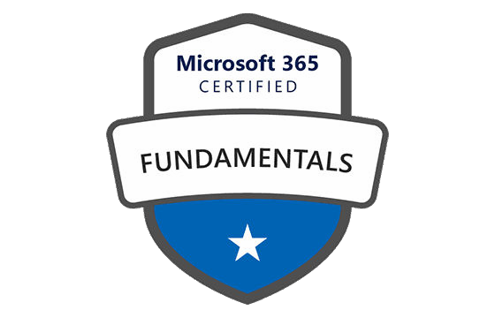
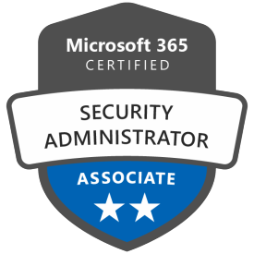
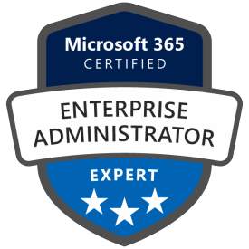
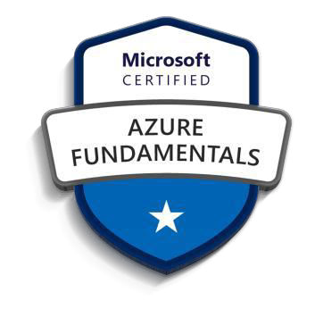
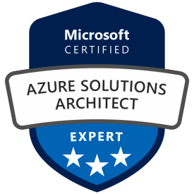
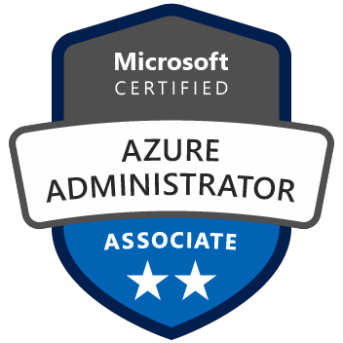
Hello! Instructor Introduction
Sandeep Kaushik
Blog: https://medium.com/@shyamsandeep28

Slide 3
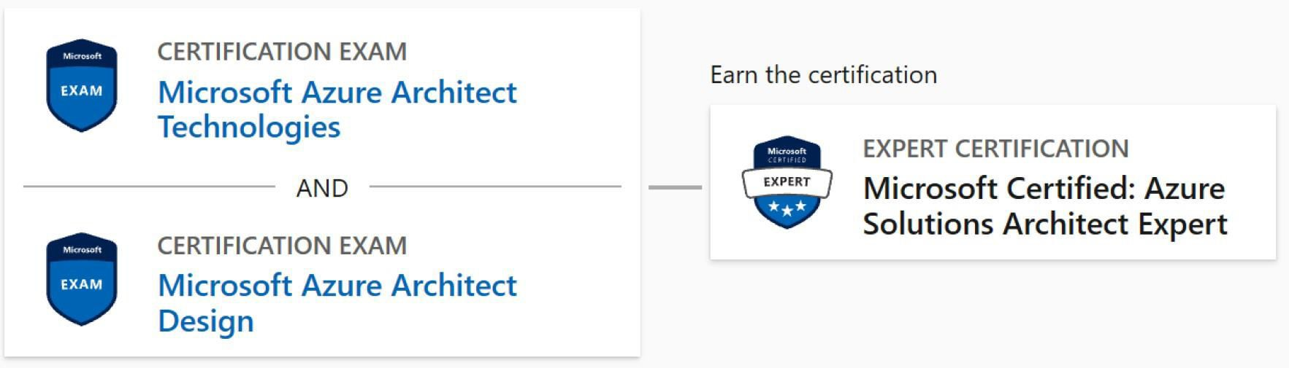
Microsoft Azure Architect Technologies

Slide 4
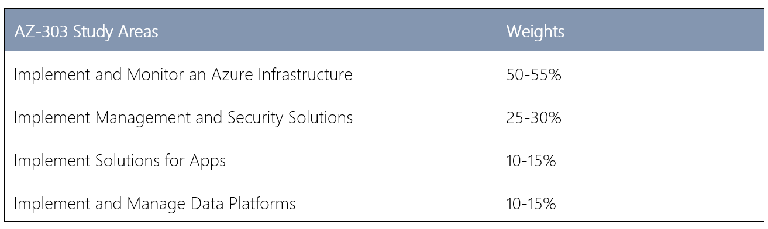
Study Areas

Slide 5
Course Outline
Module 1: Implement Azure Active Directory Module 2: Implement and Manage Hybrid Identities
Module 3: Implement Virtual Networking
Module 4: Implement VMs for Windows and Linux
Module 5: Implement Load Balancing and Network Security
Module 6: Implement Storage Accounts
Module 7: Implement NoSQL Databases Module 8: Implement Azure SQL Databases
Module 9: Automate Deployment and Configuration of Resources
Module 10: Implement and Manage Azure Governance Solutions Module 11: Manage Security for Applications
Module 12: Manage Workloads in Azure
Module 13: Implement Container-Based Applications Module 14: Implement an Application Infrastructure Module 15: Implement Cloud Infrastructure Monitoring

Slide 6
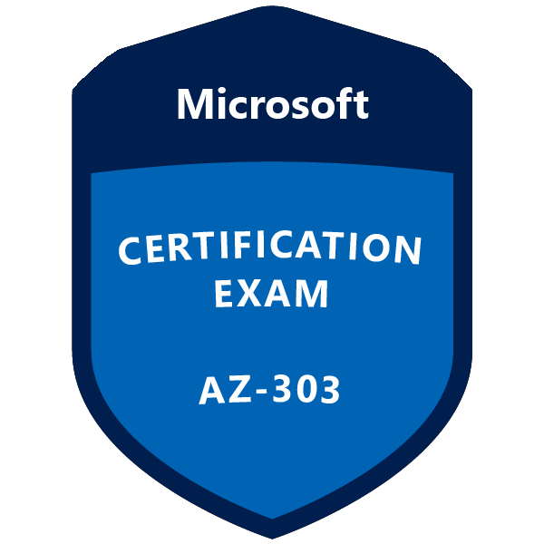


AZ- 104 & 303
Azure Active Directory

Slide 7

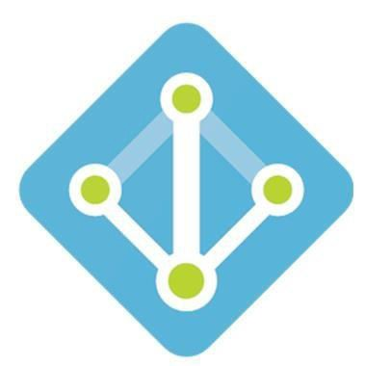
Overview of Azure Active Directory

Slide 8
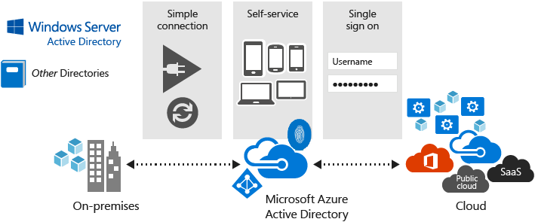
Azure Active Directory (Azure AD)

Slide 9
Benefits and Features
Single sign-on to any cloud or on-premises web app
Works with iOS, Mac OS X, Android, and Windows devices
Protect on-premises web applications with secure remote access Easily extend Active Directory to the cloud
Protect sensitive data and applications
Reduce costs and enhance security with self-service capabilities

Slide 10
Azure AD Concepts
Concept | Description
Identity | An object that can be authenticated.
Account | An identity that has data associated with it.
Azure AD Account | An identity created through Azure AD or another Microsoft cloud service.
Azure tenant | A dedicated and trusted instance of Azure AD
Azure AD directory | Each Azure tenant has a dedicated and trusted Azure AD directory.
Azure subscription | Used to pay for Azure cloud services.

Slide 11

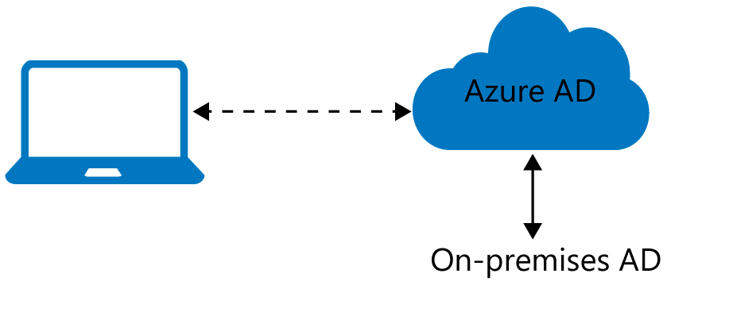



Azure AD Join
Benefits of AD Join:
Single-Sign-On (SSO) Enterprise compliant roaming
Access to Microsoft Store for Business
Windows Hello Restriction of access
Seamless access to on-premise resources
Connection Options:
Registering
Joining

Slide 12

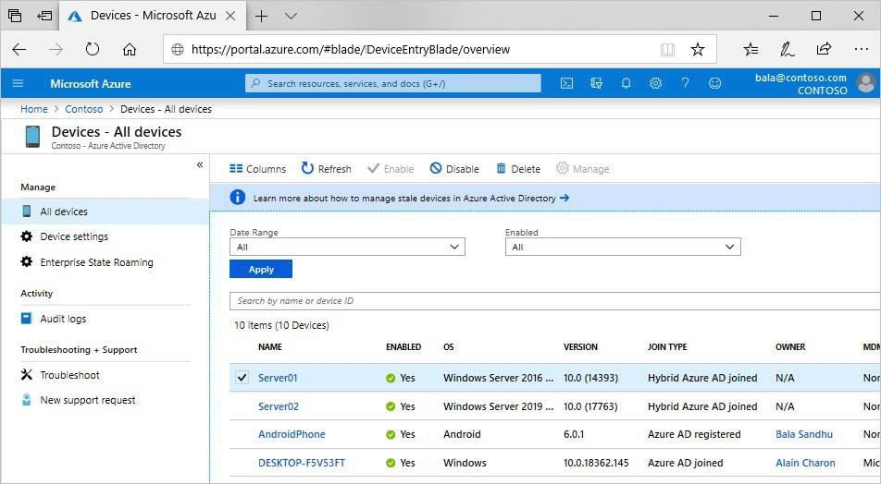
Devices in Azure AD
Azure AD Registered
Hybrid Azure AD Joined
Windows 10 iOS
Android
MacOS
Windows 7,8.1 or 10 Win Server 2008 or newer
Azure AD Joined
Windows 10
Windows Server 2019 VM

Slide 13
Azure AD Identity Protection
Risk detection type | Description
Atypical travel | Sign in from an atypical location based on the user's recent sign-ins.
Anonymous IP address | Sign in from an anonymous IP address
Unfamiliar sign-in properties | Sign in with properties we've not seen recently for the given user.
Malware linked IP address | Sign in from a malware linked IP address
Leaked Credentials | This risk detection indicates that the user's valid credentials have been leaked
Azure AD threat intelligence | Microsoft's internal and external threat intelligence sources have identified a known attack pattern

Slide 14

Episode 3
Management Groups, Subscriptions, and Resource Groups

Slide 15
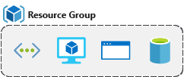
Resource Groups

Slide 16
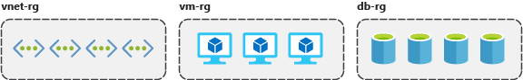
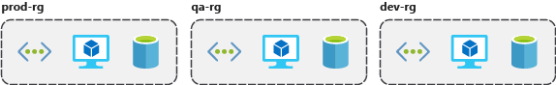
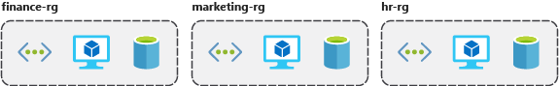
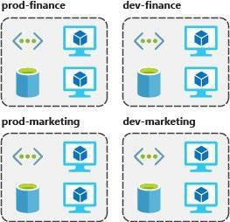
Resource Group Organization
Consistent naming convention
Organizing principles

Slide 17
Resource Group Organization
Organizing for authorization
Organizing for life cycle Organizing for billing

Slide 18
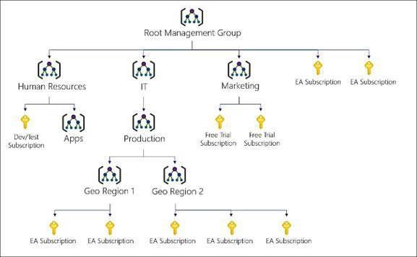
Management Groups

Slide 19
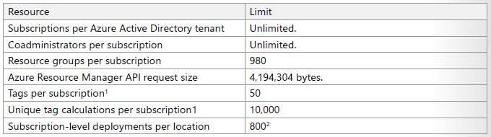
Subscriptions and Limits (Quotas)

Slide 20

Episode 4
Users and Groups

Slide 21
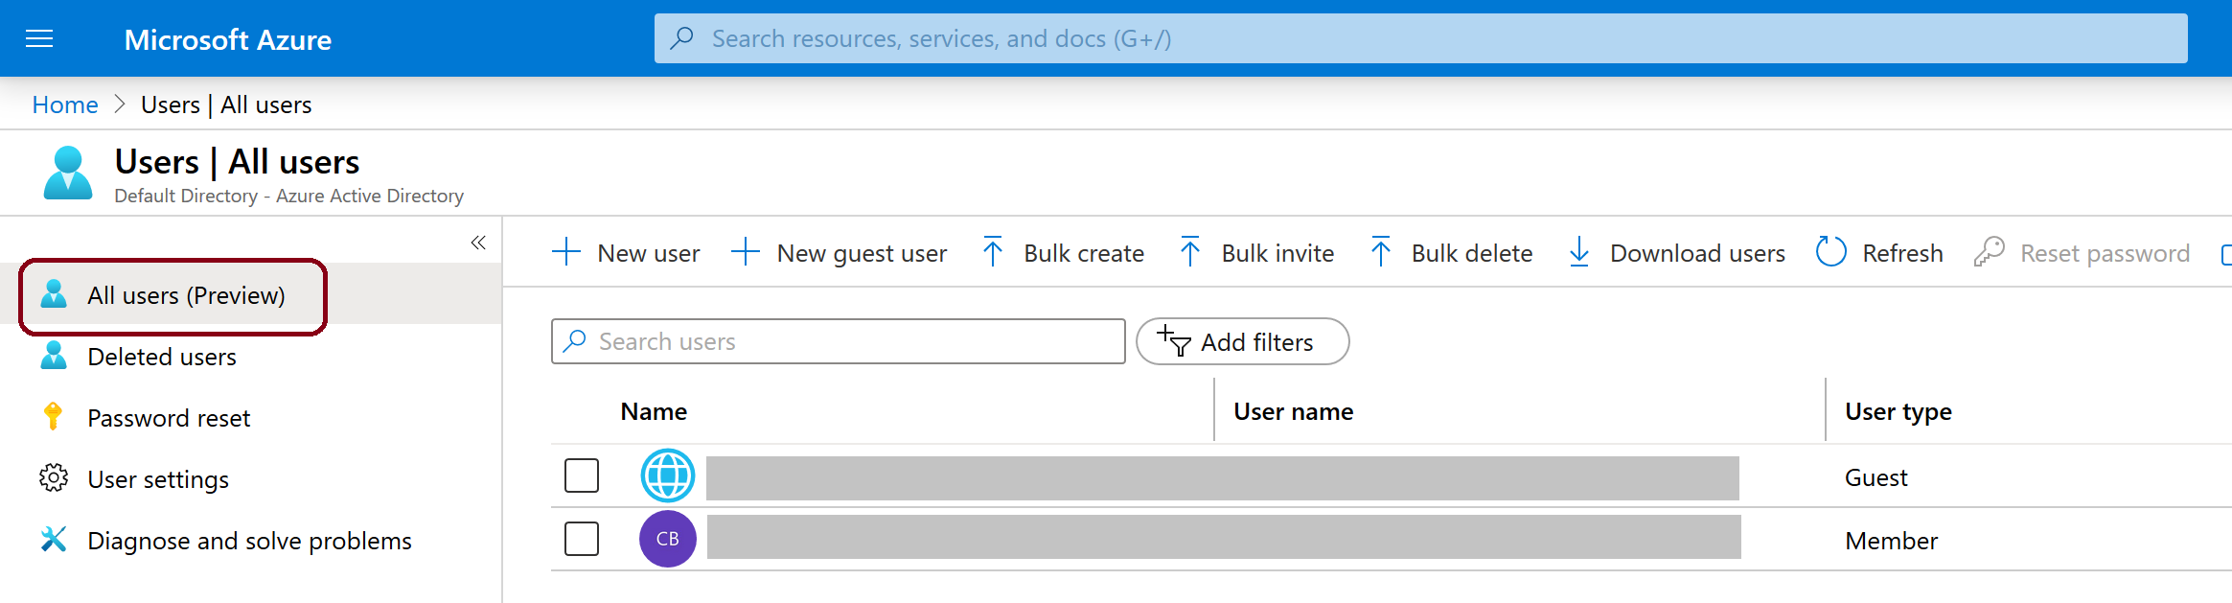


User Accounts
Cloud identities
Directory-synchronized identities Guest users

Slide 22
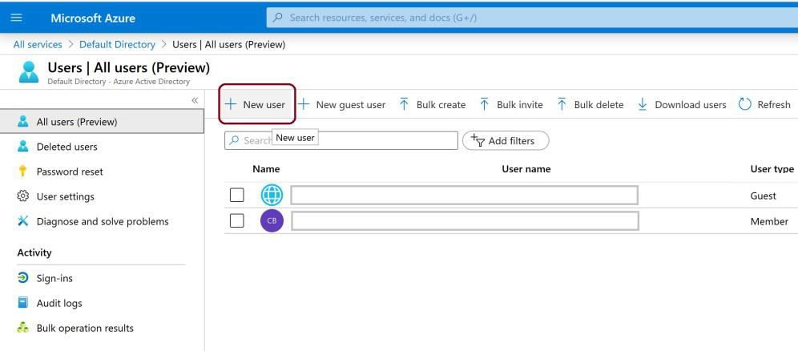
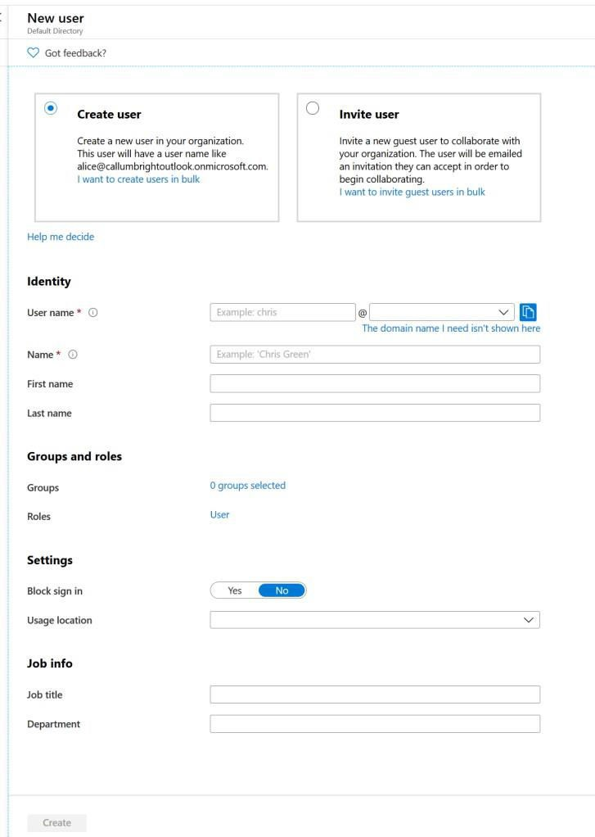
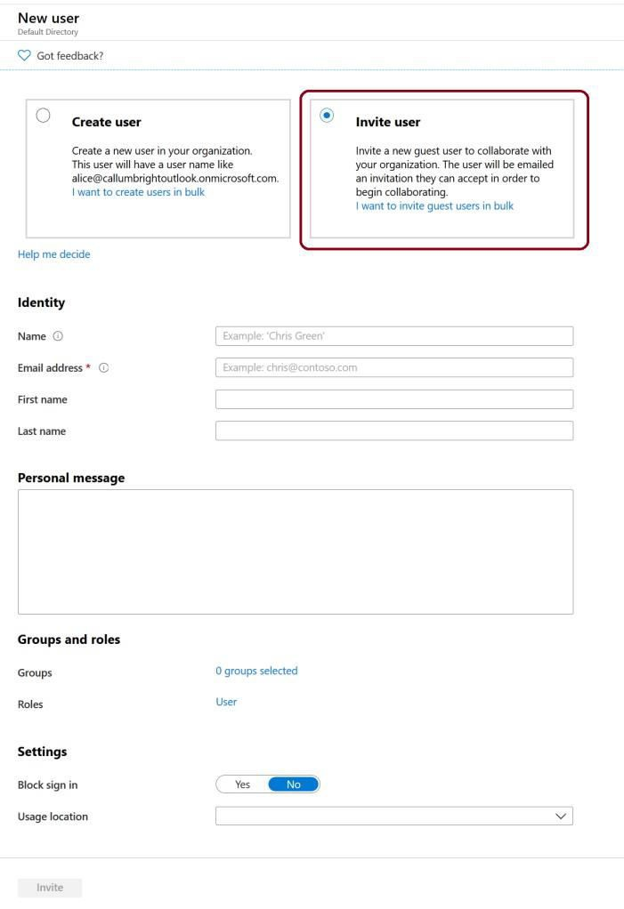
Create and Manage Users

Slide 23
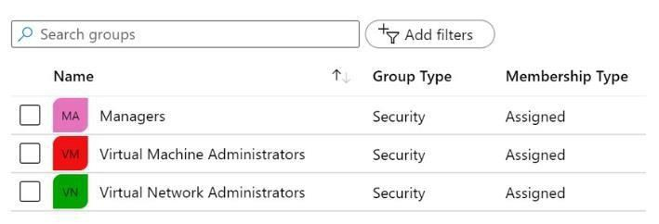

Group Accounts
Security Groups
Microsoft 365 Groups

Slide 24
Adding Members to Groups
Assigned
Dynamic User
Dynamic Device

Slide 25
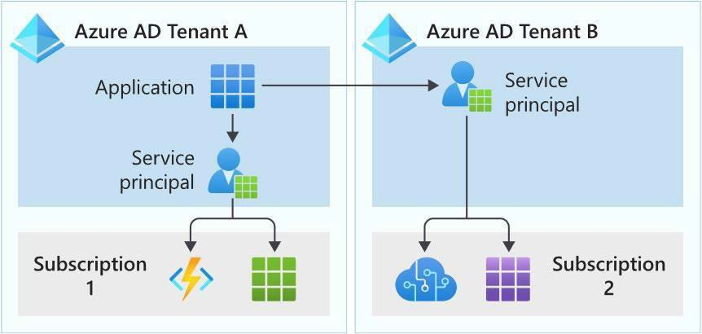
Azure Service Principals

Slide 26
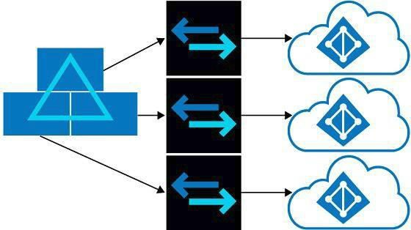
Managing Multiple Directories
Resource independence
Administrative independence
Synchronization independence

Slide 27
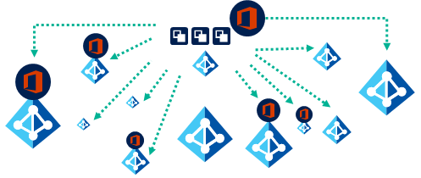
Azure B2B

Slide 28
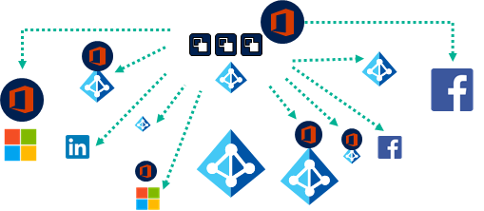
Azure AD B2C

Slide 29
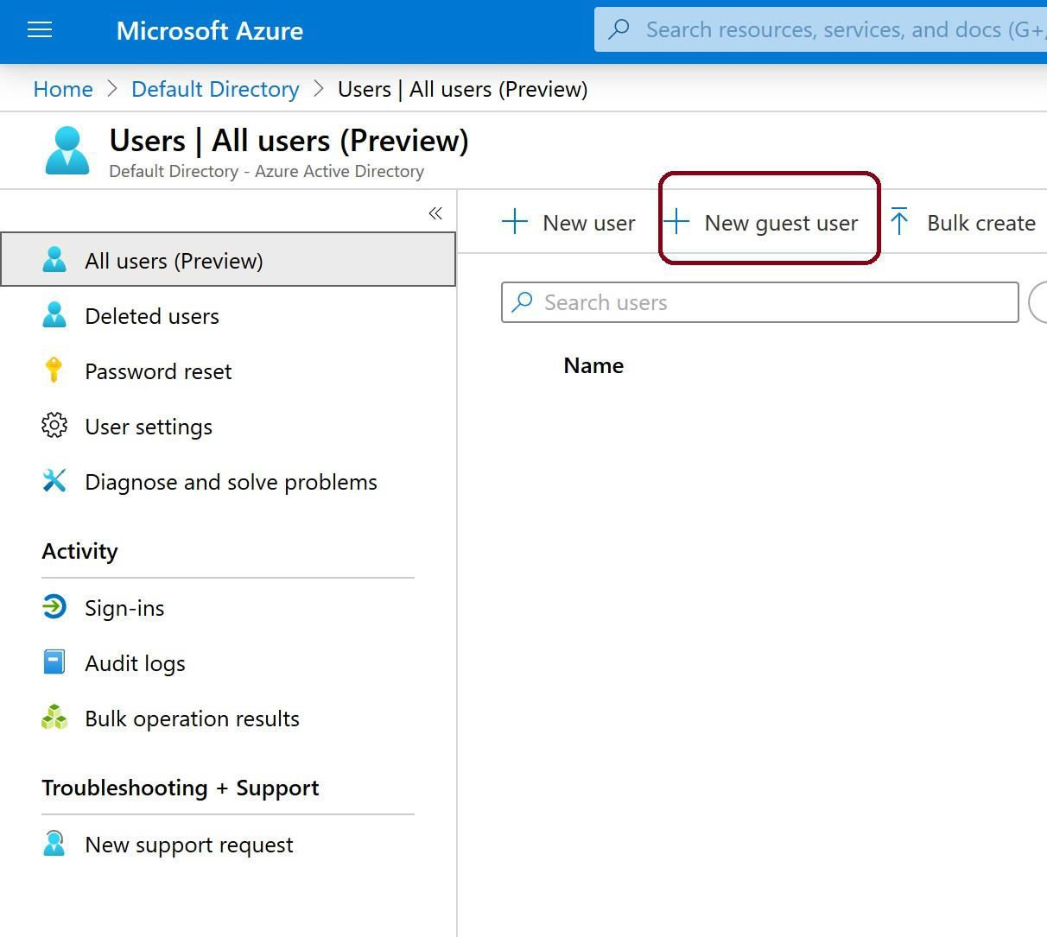
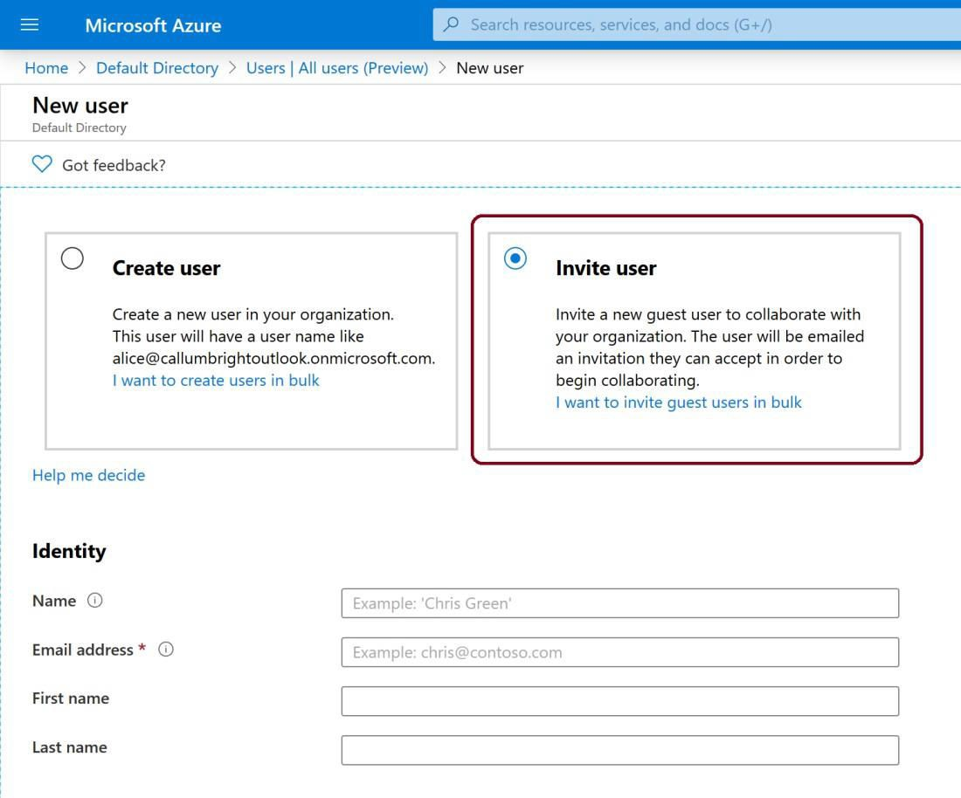
Guest Users

Slide 30
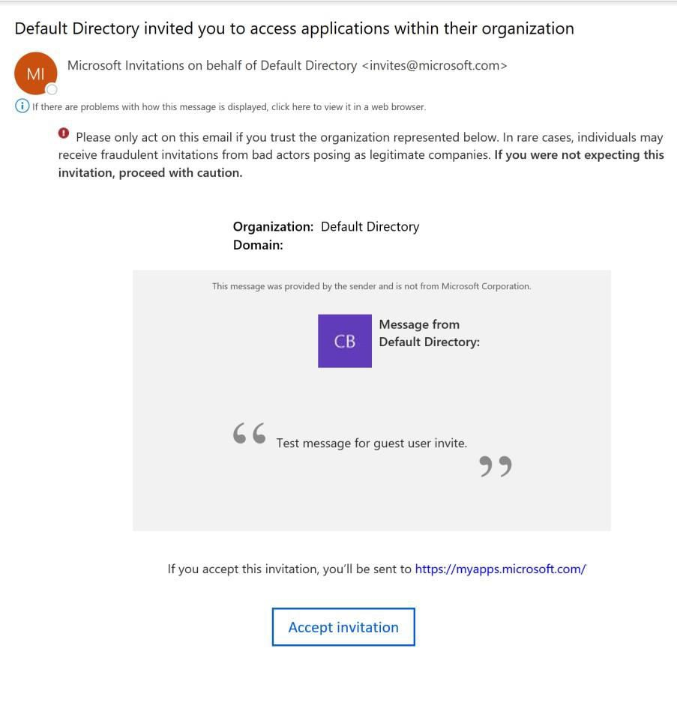
Accept the Guest Users Invite

Slide 31
Episode 5
Domains and Custom Domains

Slide 32
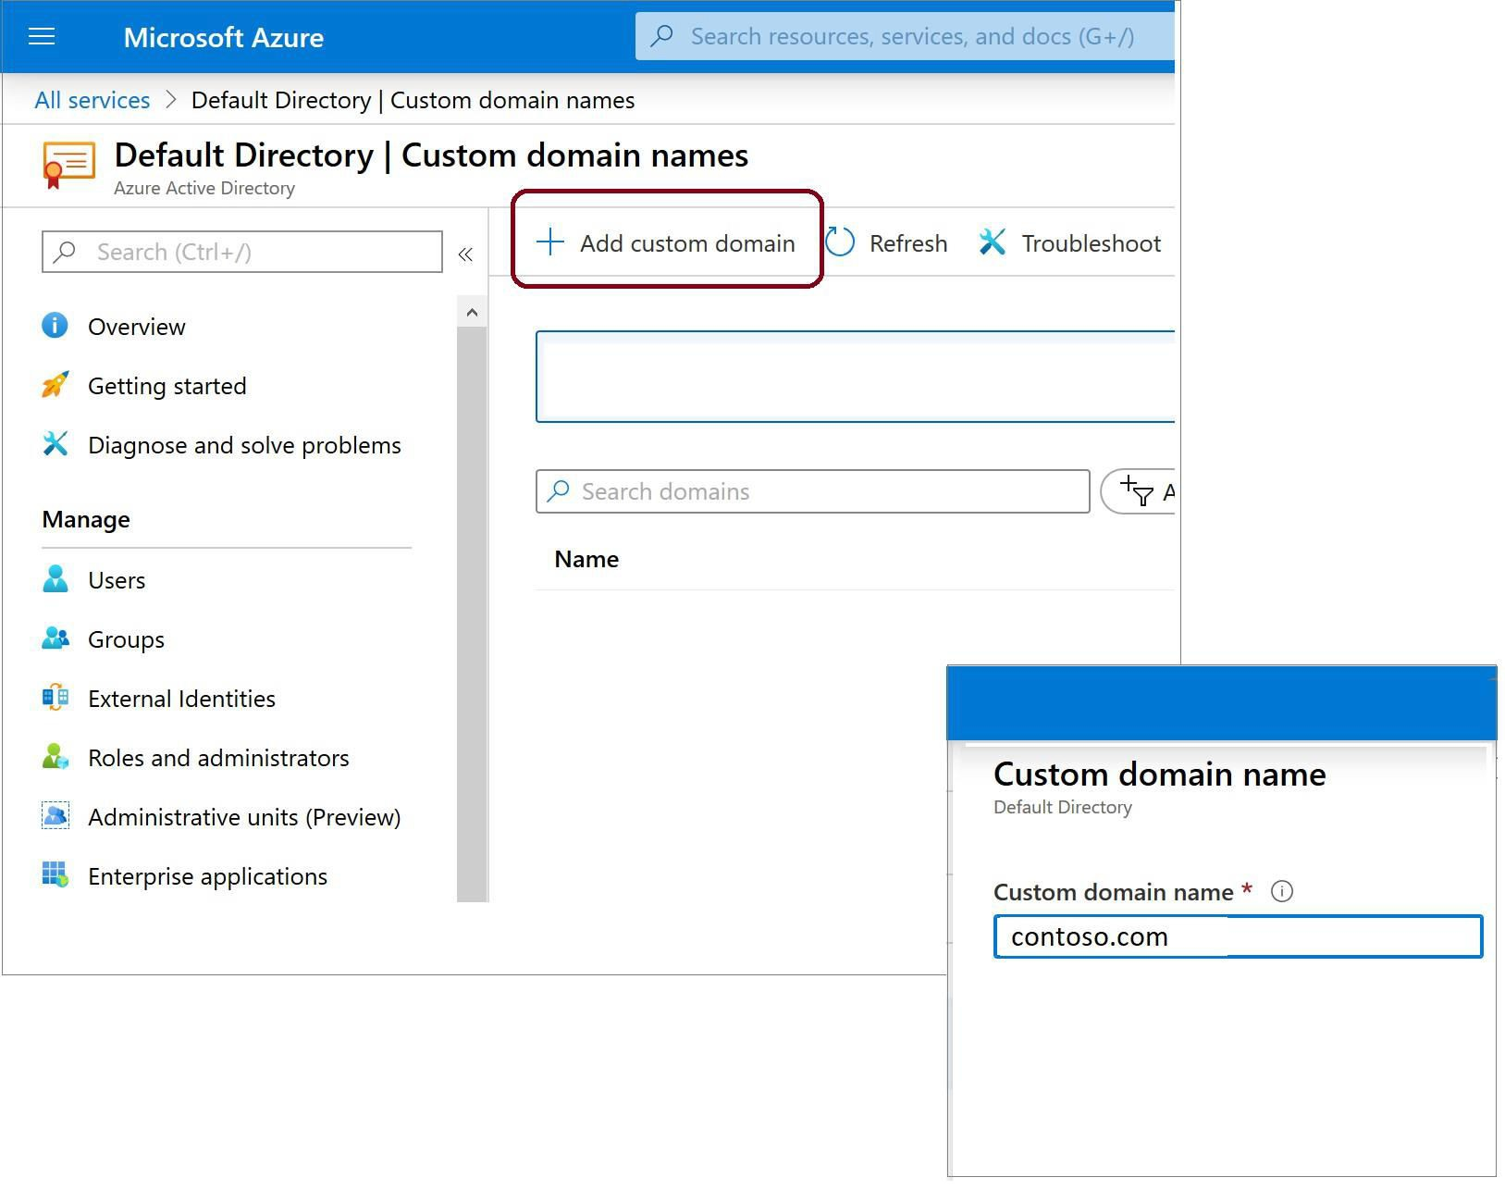

Azure AD Tenant Domain Names
Azure AD Domain Names:
Initial domain name
Custom domain name

Slide 33
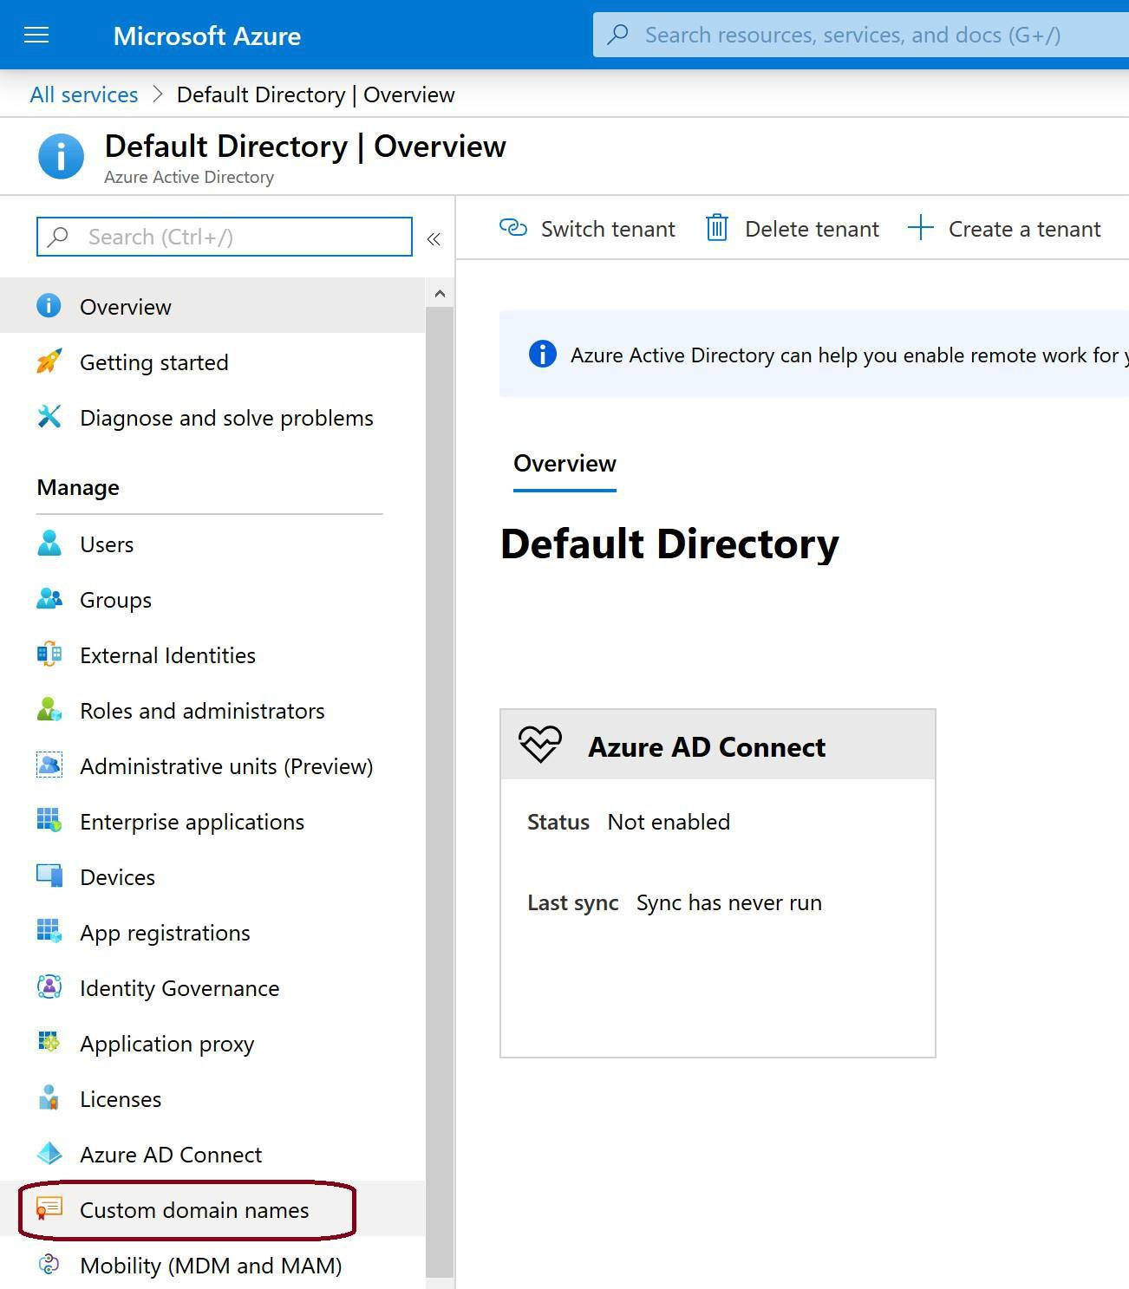
Add a Custom Domain Name to Azure AD

Slide 34
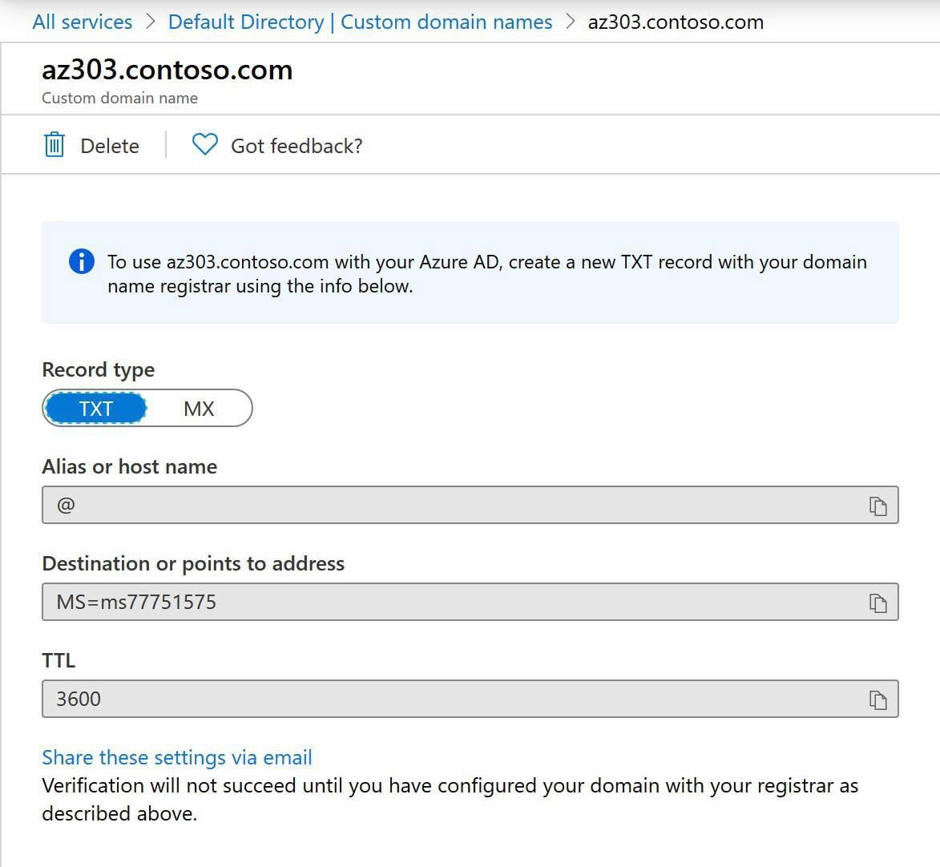
Verifying Custom Domain Names

Slide 35
Episode 6
Azure AD Conditional Access

Slide 36
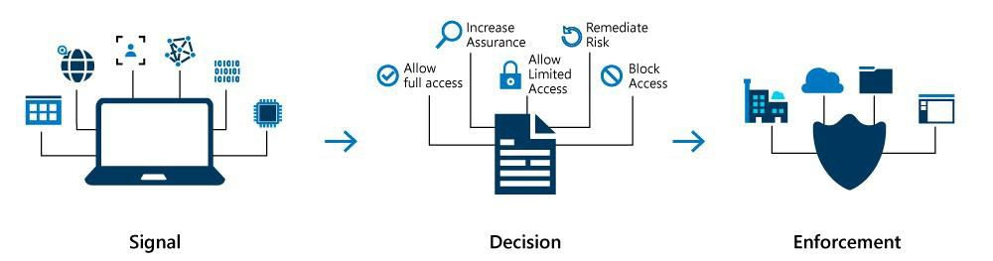
Overview of Conditional Access

Slide 37
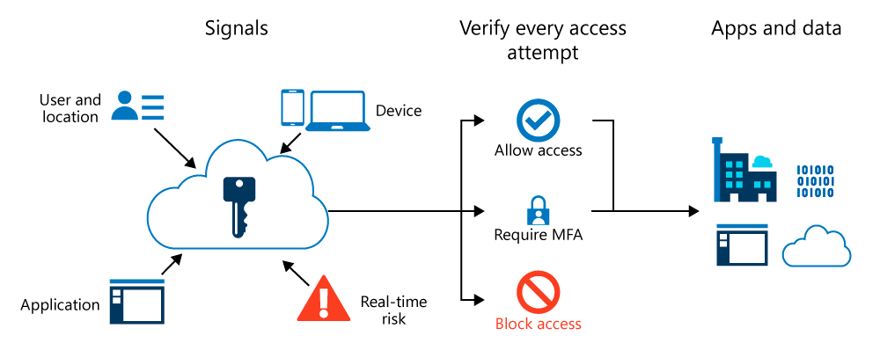
Conditional Access and Azure MFA

Slide 38

Conditional Access – Signals and Decisions
Common Signals:
Common Decisions:
User or group membership
IP location information
Device Application
Real-time & calculated risk detection Microsoft Cloud App Security-MCAS
Block Access
Grant Access

Slide 39
Episode 7
Azure Multi-Factor Authentication

Slide 40

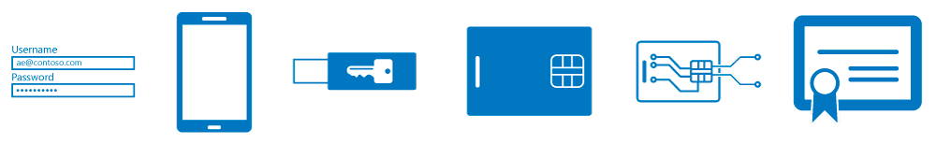
Azure MFA
Azure MFA methods:
Something you know, typically a password
Something you have
Something you are - biometrics like a fingerprint or face scan

Slide 41
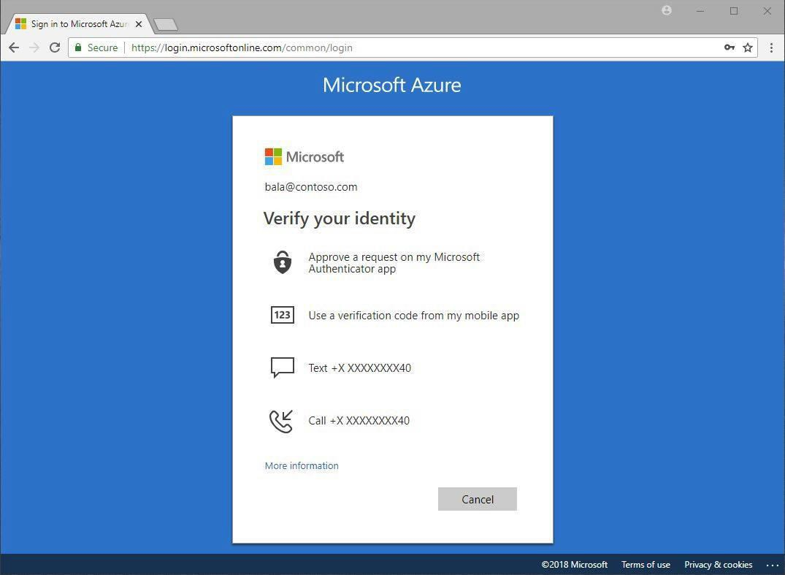
MFA Authentication Methods
Authentication methods:
Call to phone
Text message to phone
Notification through mobile app Verification code from mobile app

Slide 42
Azure MFA Settings & Reports
Settings:
Reports:
Account lockout Block/unblock users
Fraud alert
Notifications OATH tokens Phone call settings Providers
Blocked User History Usage and fraud alerts
Usage for on-premises components Bypassed User History
Server status

Slide 43
Episode 8
Self-Service Password Reset

Slide 44
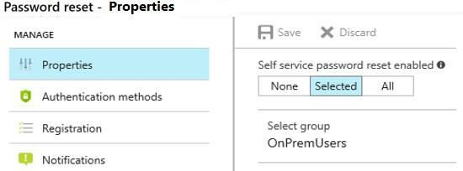
Self-Service Password Reset

Slide 45
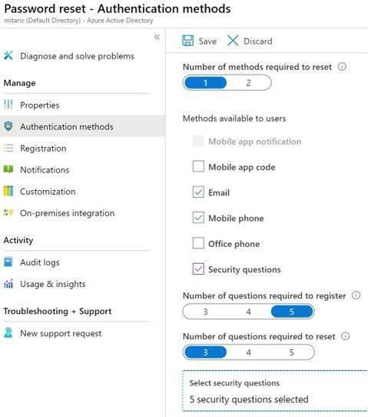
SSPR Authentication Methods
SSPR Authentication methods:
Mobile app code Email
Mobile phone
Office phone Security questions

Slide 46

Episode 9
Trusted IPs

Slide 47
Locations
Note: A location is a label for a network location that either represents a named location or multi-factor authentication Trusted IPs.

Slide 48
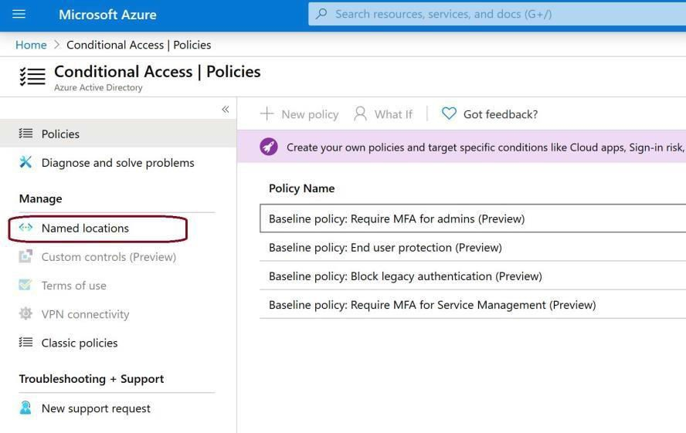
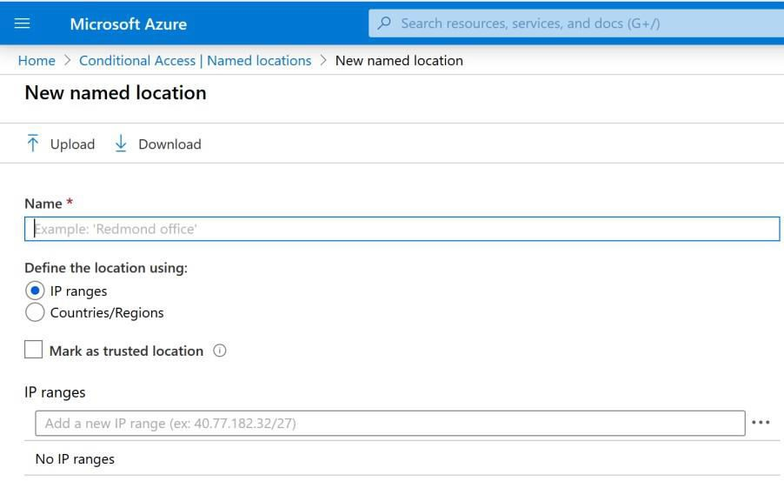
Named Locations
Named location components:
Name
IP ranges
Mark as trusted location
Countries / regions Include unknown areas

Slide 49


Trusted IPs
This feature enables you to configure up to 50
IP address ranges
The IP address ranges are in CIDR format

Slide 50
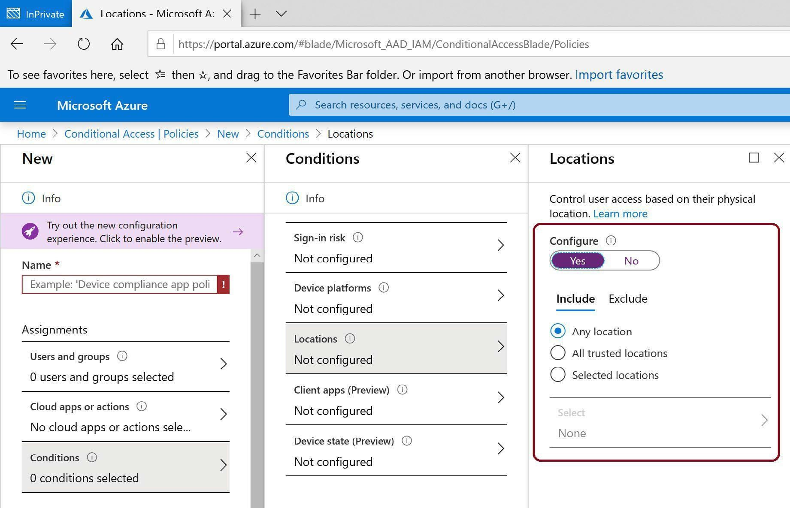
Location Condition Configuration
Any location
All trusted locations
Selected locations

Slide 51


Episode 10
Hybrid Identity

Slide 52
Hybrid Identity with Azure AD
Password hash synchronization (PHS)
Pass-through authentication (PTA) Federation (AD FS)

Slide 53
Common Scenarios and Recommendations
I need to: | PHS and SSO | PTA and SSO | AD FS
Sync new user, contact, and group accounts created in my on-premises Active Directory to the cloud automatically. | X | X | X
Set up my tenant for Office 365 hybrid scenarios. | X | X | X
Enable my users to sign in and access cloud services using their on-premises password. | X | X | X
Implement single sign-on using corporate credentials. | X | X | X
Ensure no password hashes are stored in the cloud. |  | X | X
Enable cloud-based multi-factor authentication solutions. | X | X | X
Enable on-premises multi-factor authentication solutions. |  |  | X
Support smartcard authentication for my users.⁴ |  |  | X
Display password expiry notifications in the Office Portal and on the Windows 10 desktop. |  |  | X

Slide 54


Episode 11
Azure AD Connect

Slide 55
Why use Azure AD Connect?
Implements SSO to access on-premises applications and cloud services
Simplifies deployment experience for synchronization and sign-in
Offers the latest capabilities for your scenarios

Slide 56
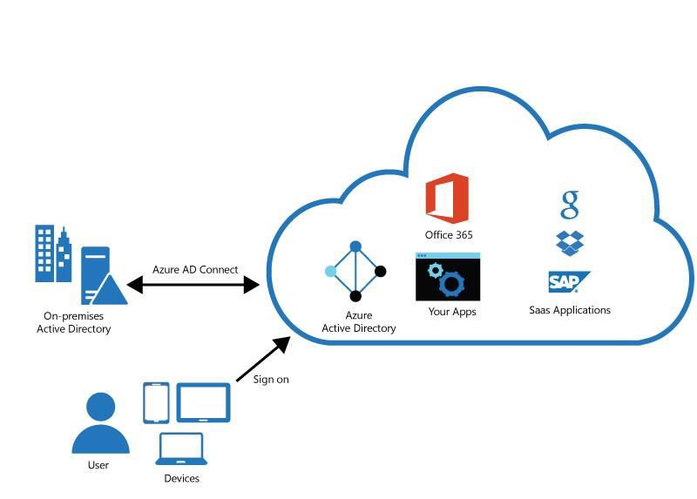


Azure AD Connect
Password hash synchronization
Pass-through authentication
Federation integration Synchronization
Health Monitoring

Slide 57
Azure AD Connect Installation
Azure AD Connect Express Settings
Azure AD Connect Custom

Slide 58
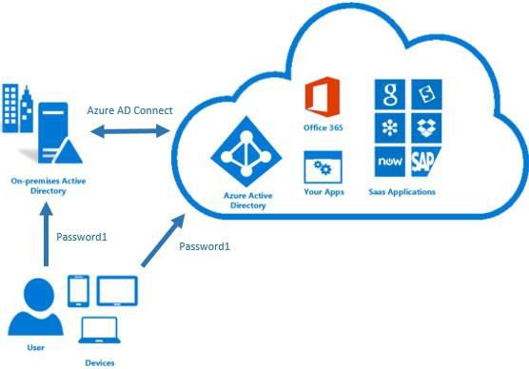
Password Hash Synchronization
Supported by Azure AD Connect
Synchronizes user passwords from AD DS to Azure AD
Allows users to use their AD credentials in order to access:
Azure resources
Office 365
Microsoft Intune
Dynamics 365
Azure AD DS
Improves user productivity
Reduces helpdesk costs

Slide 59
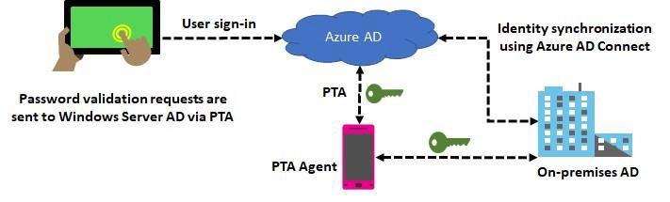
Pass-Through Authentication
Eliminates the need for password hash synchronization
Always validates credentials against Active Directory

Slide 60



Azure AD Connect Installation
Install Azure AD Connect:
Configure sync features:
Express settings
Custom settings
Filtering
Password hash synchronization
Password writeback Prevent accidental deletes
Automatic upgrade

Slide 61

Episode 12
Single Sign-On

Slide 62
Single Sign-On
With Single Sign-On
Without Single Sign-On

Slide 63
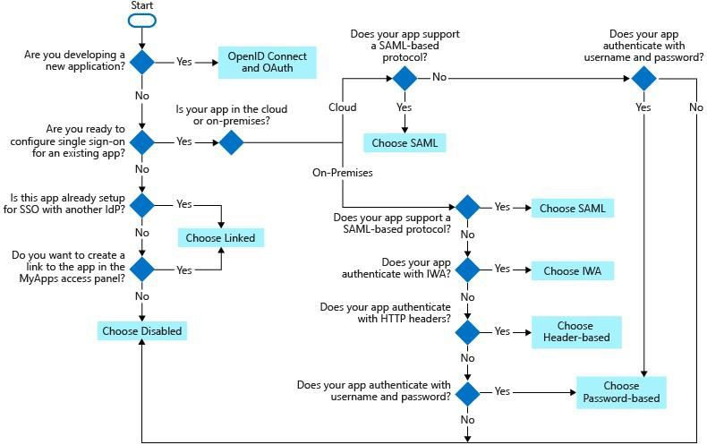
Choosing a Single Sign-on Method

Slide 64
Single Sign-On Methods
Single sign-on method | Application Types
OpenID Connect and OAuth | Cloud Only
SAML | Cloud and On-premises
Password-based | Cloud and On-premises
Linked | Cloud and On-premises
Disabled | Cloud and On-premises
Integrated Windows Authentication (IWA) | On-premises only
Header-based | On-premises only

Slide 65
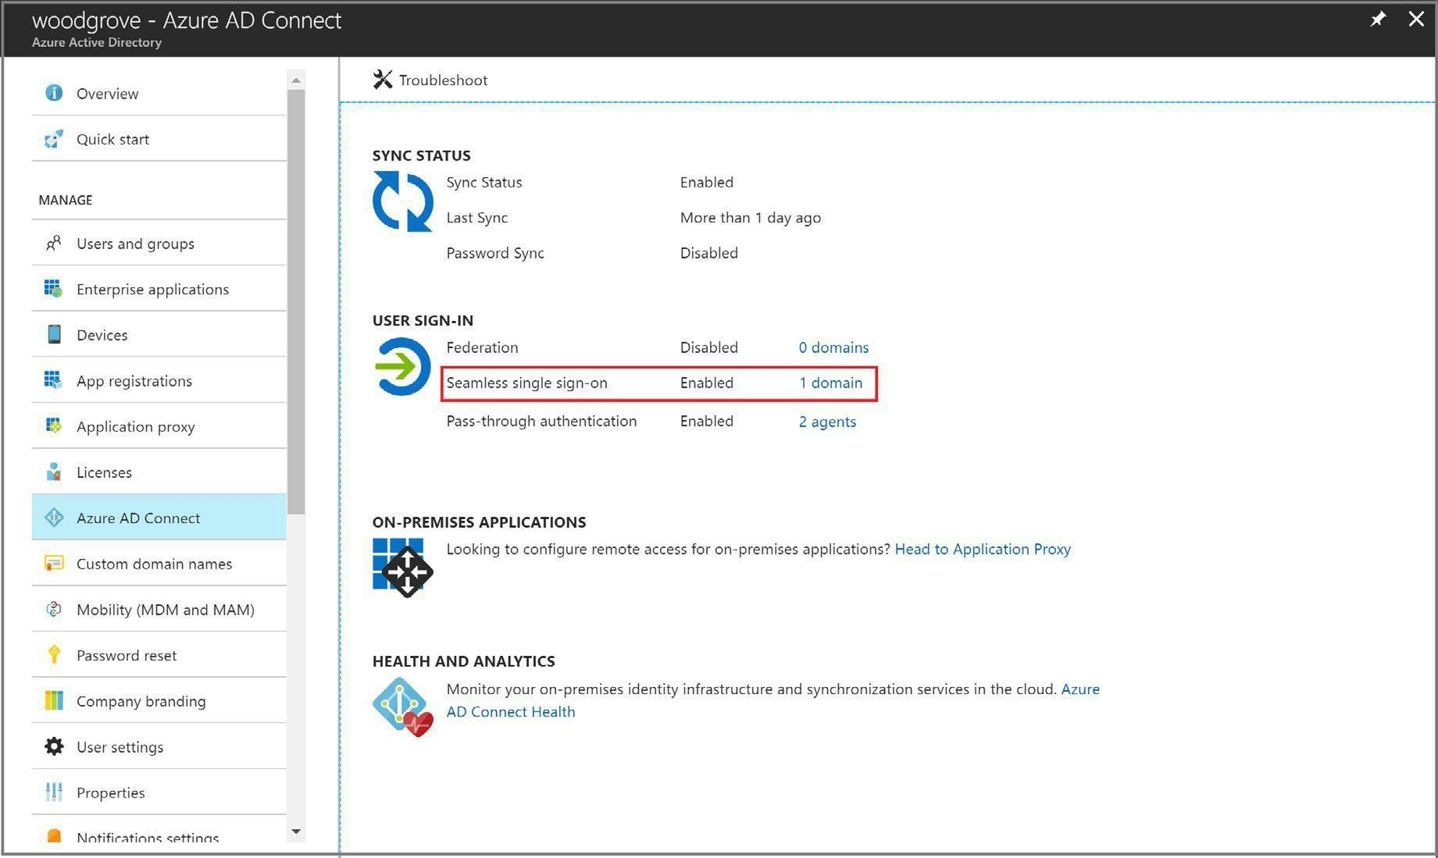
Verify Seamless SSO is enabled

Slide 66
Episode 13
Azure AD Connect Health

Slide 67
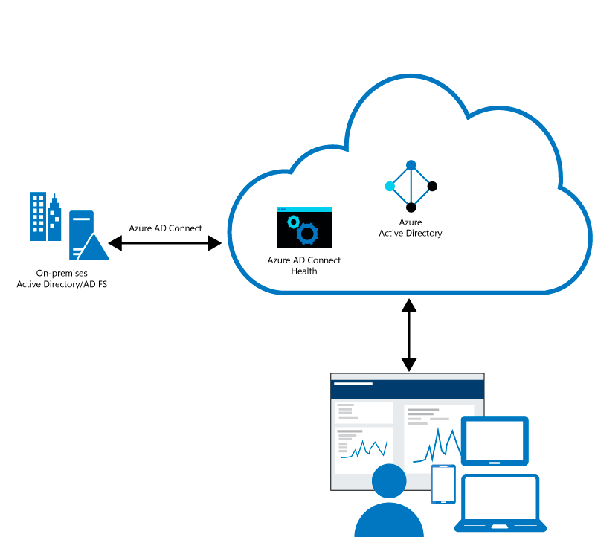
Azure AD Connect Health Overview

Slide 68
Why use Azure AD Connect Health?
Enhanced security
Alerts on all critical AD FS system issues Simplified deployment and management
Rich usage metrics
Enhanced admin experience

Slide 69

Azure AD Connect Health Portal

Slide 70
Episode 14
Azure Virtual Networking

Slide 71
Azure Virtual Networking
Azure Virtual Network (VNet) is the fundamental building block for your private network in Azure.

Slide 72
VNet Concepts
Address Space
Subnets
Regions
Subscription

Slide 73
VNet Best practices
Ensure non-overlapping address spaces
Don’t cover the entire VNet address space
Configure a few larger VNets (rather than many small ones)
Secure VNets by assigning NSGs to subnets

Slide 74

Communicate with the Internet
Outbound traffic is allowed by default
Inbound traffic can be provided via:
A public IP address A public load balancer

Slide 75
Communicate with Azure Resources
Through a virtual network
Through a virtual network service endpoint
Through VNet Peering
Through Private Link

Slide 76
Communicate with on-premises resources
Point-to-site VPN
Site-to-site VPN
Azure ExpressRoute

Slide 77

Filter Network Traffic
Network Security groups (NSG)
Network virtual appliances (NVA)

Slide 78


Route Network Traffic
Route tables
BGP routes

Slide 79
Virtual Network Integration for Azure Servcies
Dedicated Instances
Private Link
Service EndPoints

Slide 80

Episode 15
Virtual Network Peering

Slide 81

Connect Services with Virtual Network Peering

Slide 82


Types of Peering Connections
Virtual network peering
Global virtual network peering

Slide 83


Peering Considerations
Reciprocal connections
Cross-subscription peerings

Slide 84



Transitivity and Gateway Transit
Gateway Transit
Overlapping Address Spaces

Slide 85
Episode 16
Checklist for an Azure Virtual Machine

Slide 86
Checklist for creating an Azure VM
Start with the network
Name the VM
Decide the location for the VM
Determine the size of the VM
Understanding the pricing model
Storage for the VM
Select an operating system

Slide 87

Start with the Network
Segregate the network
Create one or more subnets
Secure the network
Create and assign Network Security Groups (NSGs)
Plan each VM deployment

Slide 88
Naming the VM (1 of 2)
Element | Example | Notes
Environment | dev, prod, QA | The environment for the resource
Location | uw (US West), ue (US East) | The Azure region
Instance | 01, 02 | Instance of a resource
Product or service | Service | Product, application, or service that resource supports
Role | sql, web, messaging | Role of the resource

Slide 89
Naming the VM (2 of 2)
A VM deployment includes several resources:
The VM itself
Storage account for the disks
Virtual network (shared with other VMs and services)
Network interface to communicate on the network
Network Security Group(s) to secure network traffic
Public internet address (optional)

Slide 90

Decide the Location of the VM

Slide 91
Determine the Size of the VM (1 of 2)
Azure provides different VM sizes that offer variations of
Processing power
Memory
Storage capacity
Azure provides a wide range of VM size options
General purpose
Compute optimized
Memory optimized
Storage optimized
GPU
High performance compute
Confidential computing

Slide 92
Determine the Size of the VM (2 of 2)
Option | Description
General purpose | Balanced CPU-to-memory ratio.
Compute optimized | High CPU-to-memory ratio.
Memory optimized | High memory-to-CPU ratio.
Storage optimized | High disk throughput and IO.
GPU | Heavy graphics rendering and video editing.
High performance compute | The fastest and most powerful CPU
Confidential compute | Designed to protect the confidentiality and the integrity

Slide 93
Virtual Machine Sizes
Type | Sizes
General purpose | B, Dsv3, Dv3, Dasv4, Dav4, DSv2, Dv2, Av2, DC, DCv2, Dv4, Dsv4, Ddv4, Ddsv4
Compute optimized | Fsv2
Memory optimized | Esv3, Ev3, Easv4, Eav4, Ev4, Esv4, Edv4, Edsv4, Mv2, M, DSv2, Dv2
Storage optimized | Lsv2
GPU | NC, NCv2, NCv3, ND, NDv2 (Preview), NV, NVv3, NVv4
High performance compute | HB, HBv2, HC, H
Confidential compute | DCsv2-Series

Slide 94


The Pricing Model
There are two separate costs charged for every VM
Compute costs
Storage costs
There are two main payment options for compute costs
Pay as you go
Reserved VM Instances

Slide 95
Select an Operating System
Azure provides a variety of OS images you can install into the VM, including:
All currently supported versions of Windows
All major Linux distributions
You can search Azure Marketplace for more install images
You can create your own custom images to create Azure VMs

Slide 96









Storage for the VM
Each Azure VM has two or more disks:
OS Disk
Temporary Disk
Azure VM (Windows)
Data Disk (Optional)
C:\
Operating system disk
F:\
Data disk
OS and data disks reside in Azure Storage accounts:
Azure-based storage service
D:\
Temporary disk
(contents can be lost)
Standard (HDD, SSD) or Premium (SSD), or Ultra (SSD)
When creating an Azure VM, you can choose between:
Azure blob
Managed disks (recommended)
Unmanaged disks

Slide 97
Episode 17
High Availability in Azure

Slide 98


Availability Sets

Slide 99

Availability Zones

Slide 100
Virtual Machine Sale Sets
Consist of identically configured, load balanced VMs
Support manual, scheduled and automatic scaling
Automatically distributes VMs across fault domains and update domains

Slide 101

Vertical Scaling

Slide 102

Horizontal Scaling

Slide 103

Scale Set Benefits
Simplicity: All VM instances are created using the same based OS
Load balancer support: layer 4 and layer 7
High availability: multiple instances of the same workload
Autoscaling: the number of instances adjusts dynamically based on demand
Scalability: up to 1,000 VM instances (600 when using custom images)

Slide 104

Implementing Scale Sets
Initial instance count
Instance size
Azure spot instance
Use managed disks
Enable scaling beyond 100 instances
Spreading algorithm

Slide 105

Episode 18
Azure Dedicated Hosts

Slide 106

Azure Dedicated Hosts
Benefits:
Implement hardware isolation at the physical server level
Control impact of maintenance events initiated by the Azure platform

Slide 107

High Availability Considerations
Use Availability Zones for fault isolation
Create one host group per zone
Use Fault Domains for fault isolation
Assign a fault domain for each host in the same host group
Use Availability Zones and Fault Domains
Create one host group per zone
Assign a fault domain for each host in the same host group

Slide 108



Azure Dedicated Hosts Capacity
Quotas
Pricing

Slide 109

Deploy VMs to Dedicated Hosts
Limitations:
Virtual machine scale sets are not supported on dedicated hosts
The sizes and hardware types available for dedicated hosts vary by region

Slide 110
Episode 19
Azure Disk Encryption

Slide 111

Azure Encryption Technologies
Two main encryption-based disk protection methods Azure VMs
enabled for all new and existing storage accounts
cannot be disabled
Storage Service Encryption (SSE)
managed by the VM owner
uses BitLocker on Windows VMs and DM- Crypt on Linux VMs
stores encryption keys in Azure Key Vault
Azure Disk Encryption (ADE)

Slide 112
Deciding when to use Encryption
Disk encryption methods are complementary
Storage Service Encryption (SSE) is part of Azure (mandatory)
Azure Disk Encryption (ADE) makes use of OS tools (optional)
Using both provides a defense-in-depth protection

Slide 113

Encrypt an Existing VM Disk
Azure Disk Encryption prerequisites:
An Azure key vault
A key vault access policy that enables support for disk encryption
ADE encryption keys stored in the key vault
To encrypt an existing VM disk, use:
Azure PowerShell
Azure CLI

Slide 114

Episode 20
Azure Load Balancer

Slide 115

Distribute Traffic with Azure Load Balancer
Source IP
Source port
Destination IP
Destination port
Protocol type

Slide 116

Availability Sets

Slide 117

Availability Zones

Slide 118
Select a Load Balancer Solution
Port forwarding
Automatic reconfiguration
Health probes
Outbound connections through source network address translation (SNAT)
Diagnostics through Azure Log Analytics for public-facing load balancers
HTTPS health probes
Availability zones
Diagnostics through Azure Monitor, for multidimensional metrics
High availability (HA) ports
Outbound rules
A guaranteed SLA (99.99% for two or more virtual machines in different zones)
Basic Load Balancer allow:
Standard Load Balancers Support:

Slide 119

Internal or External Load Balancers
External Load Balancer
Internal Load Balancer

Slide 120
Configure a Public Load Balancer (1 of 2)
Five-tuple hash

Slide 121

Configure a Public Load Balancer (2 of 2)
Source IP affinity

Slide 122

Choose a Distribution mode
Choose a distribution mode
None
Client IP (use for Remote Desktop Gateway)
Client IP and protocol

Slide 123
Episode 21
Azure Application Gateway

Slide 124

Application Gateway
How an application gateway accepts a request?

Slide 125



Application Gateway Components
Frontend port and listener
Backend pool

Slide 126

Application Gateway Routing (1 of 2)
Path-based routing

Slide 127


Application Gateway Routing (2 of 2)
Multiple site routing

Slide 128

Additional Features
Redirection
Rewrite HTTP headers
Custom error pages

Slide 129


Application Gateway Configuration
Front-end IP address
Listeners Routing rules
Back-end pools
Web application firewall Health probes

Slide 130
Episode 22
Web Application Firewall (WAF)

Slide 131

Web Application Firewall

Slide 132
Supported Services
Azure Application Gateway
Azure Front Door
Azure Content Delivery Network (preview)

Slide 133

Episode 23
Azure Front Door

Slide 134

Azure Front Door

Slide 135
Azure Front Door Features
Accelerate application performance
Increase application availability URL-based routing Multiple-site hosting
Session affinity TLS termination
Custom domains and certificate management URL redirection
URL rewrite
Protocol support – IPv6 and HTTP/2 traffic

Slide 136

Episode 24
Azure Traffic Manager

Slide 137

Azure Traffic Manager

Slide 138

Priority Routing

Slide 139

Performance Routing

Slide 140

Geographic Routing

Slide 141

Weighted Routing

Slide 142

Distributing Network Traffic

Slide 143

Episode 25
Azure Firewall

Slide 144

Azure Firewall

Slide 145
Azure Firewall Features
Built-in high availability
Availability zones Unrestricted cloud scalability
Application FQDN filtering rules Network traffic filtering rules Threat intelligence
Multiple public IP addresses

Slide 146

Implementing Azure Firewall
Create the network infrastructure
Deploy the firewall
Create a default route
Configure an application rule

Slide 147
Episode 26
Network Security Groups (NSGs)

Slide 148

NSG assignment and evaluation

Slide 149


Security Rules
Rules properties:
Name
Priority
Source or Destination Protocol Direction
Port range Action

Slide 150
Augmented Security rules
multiple IP addresses
multiple ports
service tags
application security groups

Slide 151
Service Tags
Service tags simplify defining rules by designating services such as:
VirtualNetwork
AzureLoadBalancer
Internet AzureTrafficManager Storage
SQL
AppService

Slide 152

Application Security Groups

Slide 153

Episode 27
Azure Bastion

Slide 154

Architecture

Slide 155
Key features
RDP and SSH directly in Azure portal
Remote session over TLS and firewall traversal for RDP/SSH
No Public IP required on the Azure VM
No hassle of managing NSGs Protection against port scanning Protection against zero-day exploits

Slide 156
Episode 28
Azure Storage Accounts

Slide 157

Azure Storage Features
Durable and highly available
Secure Scalable
Managed Accessible

Slide 158
Three categories of Azure storage
Storage for virtual machines
Unstructured data Structured data

Slide 159
General purpose storage accounts have two tiers
Standard
Premium

Slide 160




Azure Storage Services
Storage for virtual machines
Unstructured data Structured data Structured data

Slide 161
Azure Storage Account Types
Storage account type | Supported services | Supported performance tiers | Replication options
BlobStorage | Blob (block blobs and append blobs only) | Standard | LRS, GRS, RA-GRS
General-purpose V1 | Blob, File, Queue, Table, and Disk | Standard, Premium | LRS, GRS, RA-GRS
General-purpose V2 | Blob, File, Queue, Table, and Disk | Standard, Premium | LRS, GRS, RA-GRS, ZRS, ZGRS (preview), RA-ZGRS (preview)
Block blob storage | Blob (block blobs and append blobs only) | Premium | LRS, ZRS (limited regions)
FileStorage | Files only | Premium | LRS, ZRS (limited regions)

Slide 162

Data Redundancy
Locally redundant storage (LRS)
Zone-redundant storage (ZRS)
Geographically redundant storage (GRS)
Read-access geo-redundant storage (RA-GRS)
Geo-zone-redundant storage (GZRS)
Read-access geo-zone-redundant storage (RA-GZRS)

Slide 163

What is locally redundant storage (LRS)?

Slide 164

What is zone-redundant storage (ZRS)?

Slide 165

What is geographically redundant storage (GRS)?

Slide 166

What is read-access geo-redundant storage (RA-
GRS)?

Slide 167

Episode 29
Blob Storage

Slide 168
Blob Storage
Common uses of blob storage:
Serving images or documents directly to a browser
Storing files for distributed access, such as installation
Streaming video and audio
Storing data for backup and restore, disaster recovery, and archiving
Storing data for analysis by an on-premises or Azure-hosted service

Slide 169

Types of resources
Blob service includes three types of resources:
The storage account
Containers in the storage account
Blobs in a container

Slide 170

Blob Containers

Slide 171


Blob Access Tiers
Hot
Cool Archive

Slide 172

Blob Lifecycle Management

Slide 173

Uploading Blobs
Block blobs (default)
Append blobs Page blobs

Slide 174
Blob upload tools
AzCopy
Azure Storage Data Movement
Library
Azure Data Factory
Blobfuse
Azure Data Box Disk
Azure Import/Export

Slide 175

Storage Pricing
Performance tiers
Data access costs Transaction costs
Geo-Replication data transfer costs
Outbound data transfer costs Changing the storage tier

Slide 176

Episode 30
Storage Security

Slide 177

Storage Security
Encryption
Authentication
Data in transit
Disk encryption
Shared access signatures

Slide 178
Authorization options
Azure Active Directory
Shared Access Signature
Anonymous access to
containers and blobs
Shared key

Slide 179

Storage Account Keys

Slide 180

Shared Access Signatures

Slide 181


URI and SAS Parameters
Example URI

Slide 182

Storage Service Encryption (SSE)

Slide 183

Customer Managed Keys

Slide 184

Securing Storage Endpoints

Slide 185
Episode 31
Managing Storage

Slide 186


Import and Export Service
Use Cases
Migrating data to the cloud
Content distribution
Backup
Data recovery

Slide 187

Import Jobs

Slide 188


Export Jobs
Import/Export Tool (WAImportExport)

Slide 189
AZCopy
Supports Azure Data Lake Storage Gen2 APIs
Supports copying an entire account (Blob service only) to another account
Account to account copy is now using the new Put from URL APIs
List/Remove files and blobs in a given path
Supports wildcard patterns in a path
Improved resiliency
Azure Active Directory
Authentication options
SAS tokens

Slide 190
Data Transfer Tool Selection
Dataset | Network Bandwidth | Solution to use
Large Dataset | Low-bandwidth network or direct connectivity to on-premises storage is limited by organization policies | Azure Import/Export for export; Data Box Disk or Data Box for import where supported; otherwise use Azure Import/Export
Large Dataset | High-bandwidth network: 1 gigabit per second (Gbps) - 100 Gbps | AZCopy for online transfers; or to import data, Azure Stack Edge, or Azure Data Box Gateway
Large Dataset | Moderate-bandwidth network: 100 megabits per second (Mbps) - 1 Gbps | Azure Import/Export for export or Azure Stack Edge for import where supported
Small Dataset: a few GBs to a few TBs | Low to moderate-bandwidth network: up to 1 Gbps | If transferring only a few files, use Azure Storage Explorer, Azure portal, AZCopy, or AZ CLI

Slide 191

Episode 32
Azure Table Storage

Slide 192



Azure Table Storage
Azure Table is a NoSQL datastore ideal for storing structured, non-relational data.
Table Storage Concepts:
URL Format
Accounts Table
Entity Properties

Slide 193


Table Service Data Model
Storage Account
Tables, Entities, and Properties
Table Names Property Names System Properties PartitionKey Property
RowKey Property Timestamp Property

Slide 194
Episode 33
Azure Cosmos DB

Slide 195

Overview of Azure Cosmos DB

Slide 196





Cosmos DB APIs

Slide 197

High Availability with Cosmos DB

Slide 198
SLA for Availability
Operation type | Single region | Multi-region (single region writes) | Multi-region (multi-region writes)
Writes | 99.99 | 99.99 | 99.999
Reads | 99.99 | 99.999 | 99.999

Slide 199
HA in the event of Regional Outages
Multi-region accounts with a single-write region (write region outage)
Multi-region accounts with a single-write region (read region outage)

Slide 200
Benefits of using Apache Cassandra API
No operations management
Open source standard Performance management
Ability to use existing code and tools Throughput and storage elasticity
Global distribution and availability
Choice of consistency Enterprise grade Event Sourcing

Slide 201

Cosmos DB API for Mongo DB

Slide 202

Cosmos DB Gremlin API

Slide 203

Episode 34
Azure SQL Database

Slide 204

Azure SQL DB Service

Slide 205

Azure SQL DB Managed Instance

Slide 206
Features
PaaS benefits | Business continuity
No hardware purchasing and management No management overhead for managing underlying infrastructure Quick provisioning and service scaling Automated patching and version upgrade Integration with other PaaS data services | 99.99% uptime SLA Built in high-availability Data protected with automated backup. Customer configurable backup retention period User-initiated backups Point in time database restore capability

Slide 207
Capabilities
Feature | Description
SQL Server version / build | SQL Server Database Engine (latest stable)
Managed automated backups | Yes
Built-in instance and database monitoring and metrics | Yes
Automatic software patching | Yes
The latest Database Engine features | Yes
Number of data files (ROWS) per the database | Multiple
Number of log files (LOG) per database | 1
VNet - Azure Resource Manager deployment | Yes
VNet - Classic deployment model | No
Portal support | Yes
Built-in Integration Service (SSIS) | No - SSIS is a part of Azure Data Factory PaaS
Built-in Analysis Service (SSAS) | No - SSAS is separate PaaS
Built-in Reporting Service (SSRS) | No - use Power BI paginated reports instead or host SSRS on Azure VM.

Slide 208

Azure SQL DB High Availability
Basic, Standard, and General-Purpose service tier availability

Slide 209

Azure SQL DB High Availability
Premium and Business Critical service tier availability

Slide 210

Azure SQL DB High Availability
Hyperscale service tier availability

Slide 211

Azure SQL DB High Availability
Zone redundant configuration

Slide 212
Episode 35
Azure Recource Manager Templates

Slide 213

Overview of Resource Manager Templates
Template Design 1:

Slide 214

Overview of Resource Manager Templates
Template Design 2:

Slide 215

Overview of Resource Manager Templates
Template Design 3:

Slide 216
What is a Resource Manager Template?
{
"$schema": "https://schema.management.azure.com/schemas/2019-04- 01/deploymentTemplate.json#",
"contentVersion": "", "parameters": { },
"variables": { },
"functions": [ ],
"resources": [ ],
"outputs": { }
}

Slide 217
Parameters
"parameters": { "adminUsername": {
"type": "string", "metadata": {
"description": "Username for the Virtual Machine."
}
},
"adminPassword": { "type": "securestring", "metadata": {
"description": "Password for the Virtual Machine."
}
}

Slide 218
Variables
"variables": { "nicName": "myVMNic",
"addressPrefix": "10.0.0.0/16",
"subnetName": "Subnet", "subnetPrefix": "10.0.0.0/24", "publicIPAddressName": "myPublicIP", "virtualNetworkName": "MyVNET"
}

Slide 219
Functions
"functions": [
{
"namespace": "contoso", "members": {
"uniqueName": { "parameters": [
{
"name": "namePrefix", "type": "string"
}
],
"output": {
"type": "string", "value":
"[concat(toLower(parameters('namePrefix')), uniqueString(resourceGroup().id))]"
}
}
}}],

Slide 220
Resources
"resources": [
{
"type": "Microsoft.Network/publicIPAddresses",
"name": "[variables('publicIPAddressName')]", "location": "[parameters('location')]", "apiVersion": "2018-08-01",
"properties": {
"publicIPAllocationMethod": "Dynamic", "dnsSettings": {
"domainNameLabel": "[parameters('dnsLabelPrefix')]"
}

Slide 221
Outputs
"outputs": {
"hostname": { "type": "string",
"value": "[reference(variables('publicIPAddressName')).dnsSettings. fqdn]"
}
}

Slide 222
Episode 36
Azure Quickstart Templates

Slide 223

Template Gallery

Slide 224

Save a Template for a VM

Slide 225

Create a Virtual Hard Disk Template
What is an Azure virtual hard disk?
What is a virtual machine image?
What is a generalized image?
What is a specialized virtual image?

Slide 226


Create a VM from a VHD

Slide 227

Runbooks in Azure Automation

Slide 228
Episode 37
Azure Role-Based Access Control (RBAC)

Slide 229

RBAC in the Azure Portal

Slide 230




How RBAC Works
Security Principal
Role Definition
Scope

Slide 231


Role Assignment

Slide 232
Classic Subscription Administration Roles
Role | Limit | Permissions | Notes
Account Administrator | 1 per Azure account | Access the Azure Account Center Manage all subscriptions in an account Change the Service Administrator | The Account Administrator has no access to the Azure portal.
Service Administrator | 1 per Azure subscription | Manage services in the Azure portal Assign users to the Co-Administrator role | The Service Administrator has the equivalent access of a user who is assigned the Owner role at the subscription scope.
Co-Administrator | 200 per subscription | Same access privileges as the Service Administrator, but can’t change the association of subscriptions to Azure directories Assign users to the Co-Administrator role, but cannot change the Service Administrator | The Co-Administrator has the equivalent access of a user who is assigned the Owner role at the subscription scope.

Slide 233
Azure RBAC Roles
Azure role | Permissions | Notes
Owner | Full access to all resourcesDelegate access to others | The Service Administrator and Co- Administrators are assigned the Owner role at the subscription scope Applies to all resource types.
Contributor | Create and manage all of types of Azure resources Create a new tenant in Azure Active Directory Cannot grant access to others | Applies to all resource types.
Reader | View Azure resources | Applies to all resource types.
User Access Administrator | Manage user access to Azure resources

Slide 234

Azure AD Roles

Slide 235
Episode 38
Azure AD Access Reviews

Slide 236
Azure AD Access Reviews
Why are access reviews important?
When to use access reviews?
Where do you create reviews?

Slide 237

Manage Azure AD Access Review

Slide 238

Episode 39
Azure Policy

Slide 239

Azure Initiative Definitions
Browse policy definitions
Create initiative definitions
Scope the initiative definition
View Policy evaluation results

Slide 240


Policy Definitions
Many policy definitions are available.
You can import policies from GitHub.
Policy definitions have a specific JSON format.
You can create custom policy definitions.

Slide 241

Episode 40
Azure Blueprints

Slide 242

Azure Blueprints

Slide 243

Azure Blueprints vs. Azure Policy

Slide 244
Episode 41
Azure Managed Identities

Slide 245


Authentication with Azure MIs
What are Managed Identities in Azure?

Slide 246



The concept of managed identities
How managed identities work?
Client ID
Object ID
Azure Instance Metadata Service

Slide 247

Two Types
There are two types of managed identities:
System-assigned managed identity
User-assigned managed identity

Slide 248
Using Managed Identities with Azure Resources

Slide 249

Episode 42
Azure Key Vault

Slide 250



Azure Key Vault Overview
Administrator with Azure subscription creates and manages the vault and keys
Azure Key Vault
Usage logging for keys
URIs for keys
Security administrator
Azure developer

Slide 251

Key Vault Uses
Secrets management
Key management
Storing secrets
Certificate management

Slide 252

Key Vault Secret Types

Slide 253

Key Vault Terminology

Slide 254
Episode 43
Azure Migrate Server Migration

Slide 255

Overview of Azure Migrate Server Migration

Slide 256
Key Features of Azure Migrate
Azure Migrate Server
Assessment
Azure Migrate Server Migration
Database
assessment/migration
Azure Migrate appliance

Slide 257
VMWare Migration
Agentless replication
Agent based replication

Slide 258

Hyper-V Migration

Slide 259

Agent Based Migration Architecture

Slide 260

Episode 44
Azure Backup

Slide 261

Azure VM Backup Architecture

Slide 262

Microsoft Azure Backup Overview

Slide 263

Azure Backup Key Features
Block level incremental backups
Data integrity is verified in the cloud
Configurable retention policies for storing data in the cloud

Slide 264
Azure IaaS Backup Component
What is protected?
Where are backups stored?
Component
Benefits
Limits
Azure Backup Server
(can be deployed in Azure and on- premises)
App aware snapshots (VSS)
Full flexibility for when to take backups
Recovery granularity (all)
Can use Recovery Services vault
Linux support on Hyper-V and VMware VMs
Back up and restore VMware VMs
Does not require a System Center license
Cannot back up Oracle workload.
Always requires live Azure subscription
No support for tape backup
Files,
Folders,
Volumes,
VMs,
Recovery Services vault,
Locally attached disk
Applications,
Workloads,
System State
Azure IaaS VM Backup
Native backups for Windows/Linux
No specific agent installation required
Fabric-level backup with no backup infrastructure needed
Back up VMs once-a-day
Restore VMs only at disk level
Cannot back up on- premises
VMs,
All disks (using PowerShell)
Recovery Services vault

Slide 265

Recovery Services Vault Overview

Slide 266

Episode 45
Azure Site Recovery

Slide 267

Azure to Azure Architecture

Slide 268

Azure to Azure VM Protection

Slide 269

Configuration

Slide 270


Enable Replication

Slide 271


Settings
Target Location
Target Subscription Target Storage Accounts Replica Managed Disks Cache Storage Accounts Target Availability Sets Target Availability Zones

Slide 272

Customize Target Resources

Slide 273

Replication Settings

Slide 274

Test Failover

Slide 275

Recovery Plans

Slide 276

Episode 46
Azure App Service

Slide 277
Azure App Service Plans
An App Service plan defines a set of compute resources for web apps
These compute resources are analogous to the server farm in the traditional web hosting
App Service plan determines capabilities and resources available to its web apps
Web apps can share the same App Service plan
Isolate your app into a new App Service plan when
The app is resource-intensive
You want to scale the app independently from other apps
The app needs resources in a different geographical region

Slide 278

App Service Plan Pricing Tiers

Slide 279

App Service Plan Scaling
There are two workflows for Web App scaling:
Scale up
Scale out

Slide 280
Configure Networking for App Service
The VNet Integration feature has two variations:
Regional VNet Integration Gateway-required VNet Integration

Slide 281
Deployment Slots
Tier | Maximum staging slots
Free | 0
Shared | 0
Basic | 0
Standard | 5
Premium | 20
Isolated | 20

Slide 282









Azure Functions

Slide 283


Azure Logic Apps

Slide 284
Episode 47
Azure Monitor

Slide 285

Azure Monitor Service

Slide 286

Key Capabilities
Monitor and visualize metrics
Query an analyze logs
Setup alerts and actions

Slide 287


Monitoring Data Platform
Metrics
Logs

Slide 288

Log Data

Slide 289
Data Types
Azure subscription monitoring data
Application monitoring data
Guest OS monitoring data
Azure resource monitoring data
Azure tenant monitoring data

Slide 290

Azure Advisor

Slide 291


Activity Log

Slide 292
Episode 48
Sample Review Questions

Slide 293
Q1
An organization that you are advising has MFA enabled for all users.
They have MFA configured to send verification codes to their user’s cell phones.
You are asked to recommend how they should configure an additional MFA verification option for their users.
They have an Azure AD tenant.
What should you advise?
From the Security blade of Azure AD configure the Authentication settings
From the Security blade of Azure AD configure the phone call settings
From Multi-Factor Authentication, configure in the service settings
Azure Policy

Slide 294
Q2
You are advising a company that has enabled MFA for all its users.
The company’s support desk is seeing an increase in support tickets from users who are receiving MFA requests while working within the company’s main campus.
You are asked to provide a recommendation that prevents the users from receiving MFA requests while on the main campus. The company has an Azure subscription.
What do you advise?
From the MFA service settings, create a trusted IP range.
†F rom the conditional access in Azure AD, create a named location.
†F rom the conditional access in Azure AD, create a custom control.
†F rom the conditional access in Azure AD, configure organizational relationships.

Slide 295
Q3
An organization you advise has an Azure Directory forest named Tailwind.com.
They have installed an configured Azure AD Connect to use password hash synchronization as the single sign-on (SSO) approach. Note: Staging mode is enabled.
They have reviewed the synchronization results and noticed that the Synchronization Service Manager doesn’t display any previous sync jobs.
You are asked to find a way to ensure that the synchronization completes successfully.
What do you advise?
†F rom Synchronization Service Manager, run a full import
Run AD Connect and disable staging mode.
†Run AD Connect and set the SSO method to Pass-Through authentication.
†Run from Azure PowerShell, Start-AdSyncSyncCycle -policyType Initial.

Slide 296
Q4
An organization you advise has a network that contains an on-premises Active Directory forest named Tailwind.com and contains two domains: Tailwind.com & East.Tailwind.com
The forest contains user as seen below: Name: Team_User1
Domain: Tailwind.com Member of: Enterprise Admins
Name: Team _User2 Domain: Tailwind.com Member of: Domain Admins
Name: Team _User4 Domain: East.Tailwind.com Member of: Domain Users
Name: Team _User3 Domain: East.Tailwind.com Member of: Domain Admins
They plan to sync East.Tailwind.com to an Azure AD tenant by using Azure AD Connect. They need to select an account for Azure AD Connect for the connect to the forest.
Which account do you advise they use?
Team_User1
Team_User2
Team_User3
Team_User4

Slide 297
Q5
You have a VM with two NICs named NIC1 and NIC2. NIC1 is connected to the
10.10.8.0/24 subnet. NIC2 is connected to the 10.20.8.0/24 subnet. You plan to update the VM configuration to provide the following functionality:
Enable direct communication from the internet to TCP port 443.
Maintain existing communication across the 10.10.8.0/24 and 10.20.8.0/24 subnets.
Maintain a simple configuration whenever possible.
You need to update the VM configuration to support the new functionality. What should you do? Select one.
†Remove the private IP address from NIC2 and then assign a public IP address to it. Then, create an inbound security rule.
Add a third NIC and associate a public IP address to it. Then, create an inbound security rule.
Associate a public IP address to NIC2 and create an inbound security rule for TCP port 443.
Create an inbound security rule for TCP port 443.

Slide 298
Q6
You're currently using network security groups (NSGs) to control how
your network traffic flows in and out of your virtual network subnets and network interfaces.
You want to customize how your NSGs work. For all incoming traffic, you need to apply your security rules to both the virtual machine and subnet level.
Which of the following options will let you accomplish this? (Choose two)
Configure the AllowVNetInBound security rule for all new NSGs.
Create rules for both NICs and subnets with an allow action.
Delete the default rules.
Add rules with a higher priority than the default rules.

Slide 299
Q7
A company you are advising is planning to use a line-of-business, third-party software package to perform complicated data analysis. The software will use 350 VMs that are based on an Azure Marketplace VM image. You are asked to design the infrastructure for the software application server. The solution should meet the following needs:
The number of VMs that are running at any time must change when the user workload changes.
When a new version of the application is available in the Azure Marketplace it must be deployed without causing application downtime.
Use VM scale sets.
Minimize the need for ongoing maintenance.
Which two technologies would you recommend?
A single placement group
Managed disks
Auto scale
A single storage account

Slide 300
Q8
An organization you are advising is running a single application that runs on a
VM. The traffic to the application as recently been on the increase and continues to rise.
The application cannot experience downtime must scale dynamically.
You are asked to recommend an auto-scale approach so the VM can respond well to the workload requirements.
Which three options would you recommend?
Deploy application automatic horizontal scaling
Implement custom auto-scale
Create a VM scale set
Implement an Azure Load Balancer

Slide 301
Q9
You are researching Microsoft Azure for your company. The company is
considering deploying Windows-based VMs in Azure. However, before moving forward, the management team has asked you to research the costs associated with Azure VMs. You need to document the configuration options that are likely to save the company money on their Azure VMs. Which options should you document? (Each answer presents part of the solution. Select four.
Use HDD instead of SSD for VM storage.
Use unmanaged premium storage instead of managed standard storage.
Bring your own Windows custom images.
Use different Azure regions.
Use the least powerful VMs that meet your requirements.
Place all VMs in the same resource group.
Bring your own Windows license for each VM.

Slide 302

Q10
You are planning to deploy several Linux VMs in Azure. The security team
issues a policy that Linux VMs must use an authentication system other than passwords. You need to deploy an authentication method for the Linux VMs to meet the requirement. Which authentication method should you use? Select one.
SSH key pair
Azure multi-factor authentication
Access keys
Shared access signature
Security vault certificate

Slide 303
Q11
Another IT administrator creates an Azure virtual machine scale set with 5 VMs.
Later, you notice that the VMs are all running at max capacity with the CPU being fully consumed. However, additional VMs are not deploying in the scale set. You need to ensure that additional VMs are deployed when the CPU is 75% consumed. What should you do? Select one.
Enable the autoscale option.
Increase the instance count.
Add the scale set automation script to the library.
Deploy the scale set automation script.

Slide 304
Q12
Your company is preparing to deploy an application to Microsoft Azure. The app is a self- contained unit that runs independently on several servers. The company is moving the app to the cloud to provide better performance. To get better performance, the team has the following requirements:
If the CPU across the servers goes above 85%, a new VM should be deployed to provide additional resources.
If the CPU across the servers drops below 15%, an Azure VM running the app should be decommissioned to reduce costs.
You need to deploy a solution to meet the requirements while minimizing the administrative overhead to implement and manage the solution. What should you do? Select one.
Deploy the app in a virtual machine scale set.
Deploy the app in a virtual machine availability set.
Deploy the app by using a resource manager template.
Deploy the app and use PowerShell Desired State Configuration (DSC).

Slide 305
Q13
Your company provides customers a virtual network in the cloud. You have
dozens of Linux virtual machines in another virtual network. You need to install an Azure load balancer to direct traffic between the virtual networks. What should you do? Select one.
Install a private load balancer.
Install a public load balancer.
Install an external load balancer.
Install an internal load balancer.
Install a network load balancer.

Slide 306
Q14
You are advising a company that is planning to create a virtual network that has a scale set that contains ten VMs. They have a monitoring solution on a separate network that will need to access the VMs within the scale set. They want to define public access to the virtual machines. You recommend that they implement an Azure Load Balancer to for connecting the monitoring solution to the VMs. Does this recommendation fulfill the goal?
Yes
No

Slide 307
Q15
Your organization has Azure VMs deployed to three Azure regions. Each region
contains a single virtual network that has four VMs on the same subnet. Each virtual machine runs an application named OEM_APP_3. OEM_APP_3 is accessible by using HTTPs.
The VMs are cannot be accessed from the Internet.
You are asked to use Azure Front Door to load balance requests from OEM_SQL_3 across all the VMs.
What other Azure service should you enable?
An internal Azure Load Balancer
Azure Private Link
A public Azure Load Balancer
Enable High Availability ports

Slide 308

Q16
Your organization has several Linux virtual machines. You would like to use Log
Analytics to retrieve error messages for these machines. You plan to automate the process, so you create a search query. You begin the query by identifying the source table. Which source table do you use?
Select one.
Event
SysLog
Heartbeat
MyLog_CL
Alert

Slide 309
Q17
You are advising a company that has an Azure subscription containing two
storage accounts named TailwindStorage1 and TailwindStorage2. Both storage accounts contains a queue service, table service, and a blob service.
You recommend they develop two separate applications named TaiwindApp_1 and TaiwindApp_2.
They will need to configure the applications to store different types of data to all the storage services on TailwindStorage1 and TailwindStorage2.
How many endpoints should you recommend they configure for each of the applications?
❑ 2
❑ 3
❑ 6
❑ 12

Slide 310
Q18
Your organization has a SQL Server on an Azure virtual machine named
OEM_SQL_3. You’ve been asked to provide a solution to automate backup of the databases on OEM_SQL_3 using Automated Backup V2 for the virtual machines. The requirements are as follows:
Meet the RPO of 15 minutes
Retain the backups for 30 days
Encrypt the backups at rest
As part the solution you will be providing, what should you include?
An Azure Storage account
A Key Vault
An Azure SQL Managed Instance
An Azure Logic App

Slide 311
Q19
You work for an open source development company. You use Microsoft Azure for a variety of storage needs. Up to now, all the storage was used for internal purposes only. It is organized in block blobs. Each block blob is in its own container. Each container is set to default settings. In total, you have 50 block blobs. The company has decided to provide read access to the data in the block blobs, as part of releasing more information about their open source development efforts.
All block blobs must be readable by anonymous internet users.
You need to reconfigure the storage to meet the following requirements:
Create a new container, move all the blobs to the new container, and then set the public access level to Blob.
Set the public access level to Blob on all the existing containers.
Create a new shared access signature for the storage account and then set the allowed permissions to Read, set the allowed resource types to Object, and set the allowed services to Blob.
Create a new access key for the storage account and then provide the connection string in the storage connectivity information to the public.

Slide 312
Q20
Your company is planning to storage log data, crash dump files, and other
diagnostic data for Azure VMs in Azure. The company has issued the following requirements for the storage:
Administrators must be able to browse to the data in File Explorer.
Access over SMB 3.0 must be supported.
The storage must support quotas.
You need to choose the storage type to meet the requirements. Which storage type should you use? Select one.
Azure Files
Table storage
Blob storage
Queue storage

Slide 313
Q21
Your company provides cloud software to audit administrative access in
Microsoft Azure resources. The software logs all administrative actions (including all clicks and text input) to log files. The software is
about to be released from beta and the company is concerned about storage performance. You need to deploy a storage solution for the log files to maximize
performance. What should you do? Select one.
Deploy Azure Files using SMB 3.0.
Deploy Azure Table Storage.
Deploy Azure Queues Storage.
Deploy blob storage using block blobs.
Deploy blob storage using append blobs.

Slide 314
Q22
A company you are advising wants to create the following Azure Cosmos DB databases for their
dev team.
OEM_Cosmos_Database_A: 1500 RU/sec throughput Multiple write regions Uses the Core (SQL) API
OEM_Cosmos_Database_B: 1100 RU/sec throughput Use the MongoDB API
OEM_Cosmos_Database_C: 1500 RU/sec throughput Single write region
Uses the Core (SQL) API
OEM_Cosmos_Database_D: 900 RU/sec throughput Use the MongoDB API
As a part of the solution, they want to reduce costs. You advise they create the Azure Cosmos DBs with two of the following recommendations:
Create three Azure Cosmos DB accounts, one for DBs that use MongoDB API, one for OEM_Cosmos_Database_A, and one for OEM_Cosmos_Database_C.
Create a single Azure Cosmos DB that includes the OEM_Cosmos_Database_A, OEM_Cosmos_Database_B, OEM_Cosmos_Database_C, and OEM_Cosmos_Database_D.
Create one Azure Cosmos DB account for each DBs listed above.
Create two Azure Cosmos DB accounts, one for those that use the Core (SQL) API and one for those that use MongoDB API.

Slide 315
Q23
The same company also wants to create an app that uses a separate NoSQL DB
that will be used to store transactions and supplier information using JSON files. You recommend their developers use which of the two Cosmos DB APIs for the app:
Core (SQL) API
Azure SQL Database REST API
MongoDB API
Cassandra
Deploy blob storage using append blobs.

Slide 316
Q24
You are advising a auto parts company that has the following:
OEMDabaBase_1: Microsoft SQL Server
OEMDabaBase_2: Microsoft SQL Server
OEMApplication_1: Uses data from both databases listed above
The company wants to move both databases to Azure and they are asking for recommendations for services needed to host in Azure.
Also, the recommendation must include support for server-side transactions
between the two databases. You recommend they deploy both databases as Azure SQL Databases on the same Azure SQL Database server.
Is this the right solution?
Yes
No

Slide 317
Q25
You are advising a auto parts company that has the following:
OEMDabaBase_1: Microsoft SQL Server
OEMDabaBase_2: Microsoft SQL Server
OEMApplication_1: Uses data from both databases listed above
The company wants to move both databases to Azure and they are asking for recommendations for services needed to host in Azure. Also, the recommendation must include support for server- side transactions between the two databases.
You recommend they deploy both databases (OEMDabaBase_1 and OEMDabaBase_2) to sQL Server on an Azure VM.
Is this the right solution?
Yes
No

Slide 318
Q26
You are advising an auto parts company that is running the following Azure SQL
Database servers:
OEM_SQLSvr_1:
Resource Group: Resource_Group_1 Location: East US
OEM_SQLSvr_3:
Resource Group: Resource_Group_1 Location: North Europe
OEM_SQLSvr_4:
Resource Group: Resource_Group_2 Location: North Europe
OEM_SQLSvr_2:
Resource Group: Resource_Group_1 Location: East US
The plan to make OEM_SQLSvr_1 as the primary server within a failover group. Which server should you recommend as the secondary server?
OEM_SQLSvr_3 and OEM_SQLSvr_4
OEM_SQLSvr_2 and OEM_SQLSvr_3
OEM_SQLSvr_2 and OEM_SQLSvr_4

Slide 319
Q27
Which of the following best describes the format of an Azure Resource Manager template? Select one.
A Markdown document with a pointer table
A JSON document with key-value pairs
A TXT document with key-value pairs
An XML document with element-value pairs

Slide 320
Q28
Your manager asks you to explain how Azure uses resource groups. You provide all of the following information, except? Select one.
Resources can be in only one resource group.
Resources can be moved from one resource group to another resource group.
Resource groups can be nested.
Role-based access control can be applied to the resource group.

Slide 321
Q29
You are creating a new resource group to use for testing. Which two of the following parameters are required when you create a resource group with PowerShell or the CLI? Select two.
Location
Name
Region
Subscription
Tag

Slide 322
Q30
You are asked to make recommendation to a company whose network contains
an on-premises Active Directory and an Azure AD tenant.
They have deployed Azure AD Connect and have configured pass-through authentication.
Their Azure subscription contains many web apps that are accessed from the Internet.
They plan to use Azure MFA with the Azure AD tenant.
You are asked to recommend a solution that prevents users from being prompted for Azure MFA while accessing apps from the on-premises network. What do you advise?
Trusted IPs
A site-to-site VPN between the on-premises network and Azure
Azure ExpressRoute
Azure Policy

Slide 323
Q31
An organization has an Azure subscription named Tailwind_Subcription_1 that contains an Azure VM named Tailwind_VM_1 within the resource group named Tailwind_RG_1.
Tailwind_VM_1 runs services that are used to deploy resources in Tailwind_RG_1.
They want to ensure that the service on running Tailwind_VM_1 can manage the resources in Tailwind_ RG_1 by using the identity of Tailwind_VM_1.
Managed Identity has not been enabled on the VM.
What do you advise they do first?
From the Azure portal, modify the Identity Access Control (IAM) settings for Tailwind_VM_1.
From the Azure portal, modify the value of the Identity option for Tailwind_VM_1.
From the Azure portal, modify the Policies settings for Tailwind_RG_1.
From the Azure portal, modify the Access Control (IAM) settings or Tailwind_RG_1.

Slide 324
Q32
Your company hires a new IT administrator. She needs to manage a resource
group with first-tier web servers including assigning permissions . However, she should not have access to other resource groups inside the subscription. You need to configure role-based access. What should you do? Select one.
Assign her as a Subscription Owner.
Assign her as a Subscription Contributor.
Assign her as a Resource Group Owner.
Assign her as a Resource Group Contributor.

Slide 325
Q33
You have three virtual machines (VM1, VM2, and VM3) in a resource group. The
Helpdesk hires a new employee. The new employee must be able to modify the settings on VM3, but not on VM1 and VM2. Your solution must minimize administrative overhead. What should you do? Select one.
Assign the user to the Contributor role on the resource group.
Assign the user to the Contributor role on VM3.
Move VM3 to a new resource group and assign the user to the Contributor role on VM3.
Assign the user to the Contributor role on the resource group, then assign the user to the Owner role on VM3.

Slide 326
Q34
You download an Azure Resource Manager template based on an existing virtual
machine.
The template will be used to deploy 300 virtual machines.
You need to modify the template to reference an administrative password. You must prevent the password form being stored in plain text.
What should you create to store the password?
Azure AD Identity Protection and an Azure Policy
A Recovery Services vault and a backup policy
An Azure Key Vault and an access policy
An Azure Storage account and an access policy

Slide 327
Q35
A company has an Azure subscription that contains the Azure virtual machines
shown below.
Name: TeamVM1
Operating System: Windows Server 2012 R2 Location: East US
Name: TeamVM2
Operating System: Windows Server 2016 Location: East US
Name: TeamVM3
Operating System: Windows Server 2019 Location: West US
Name: TeamVM4
Operating System: Ubuntu Server 18.04
Location: East US They create and Azure Key Vault named Vault1 in East US location.
They need to identify which virtual machines can enable Azure Disk Encryption using Vault1. Which virtual machines would you identify?
TeamVM3 only
TeamVM2 and TeamVM3 only
TeamVM1, TeamVM2, and TeamVM4 only
TeamVM1, TeamVM2, and TeamVM3 only

Slide 328
Q36
Your organization needs a way to create application aware snapshots, and
backup Linux virtual machines and VMware virtual machines. You have files, folders, volumes, and workloads to protect.
You recommend which of the following solutions? Select one.
Azure Backup (MARS) agent
Azure Backup Server
Enable disk snapshots
Enable backup for individual Azure VMs

Slide 329
Q37
You plan to use Azure Backup to protect your virtual machines and data and are
ready to create a backup.
What is the first thing you need to do? Select one.
Define recovery points.
Create a Recovery Services vault.
Create a Backup policy.
Install the Azure VM Agent.

Slide 330
Q38
You have several Azure VMs that are currently running production workloads.
You have a mix of Windows Server and Linux servers and you need to implement a backup strategy for your production workloads.
Which feature should you use in this case? Select one.
Managed snapshots.
Azure Backup.
Azure Site Recovery.
Azure Migrate.

Slide 331
Q39
You deploy several virtual machines (VMs) to Azure. You are responsible for
backing up all data processed by the VMs. In the event of a failure, you need to restore the data as quickly as possible. Which of these options would you recommend to restore a database used for development on a data disk?
Select one.
Virtual machine backup
Azure Site Recovery
Disk image backup
Disk snapshot

Slide 332
Q40
You decide to move all your services to Azure Kubernetes service. Which of the following components will contribute to your monthly Azure charge?
Select one.
Master node
Pods
Node virtual machines
Tables

Slide 333
Q41
Which of the following is not true about container groups? Select one.
Is scheduled on a multiple host machines.
Is assigned a DNS name label.
Exposes a single public IP address, with one exposed port.
Consists of two containers.
Includes two Azure file shares as volume mounts.

Slide 334
Q42
Which of the following is the Kubernetes agent that processes the orchestration
requests from the cluster master, and schedules running the requested containers?
Select one.
controller master
container runtime
kube-proxy
kubelet

Slide 335
Q43
You are configuring networking for the Azure Kubernetes service. Which of the following maps incoming direct traffic to the pods?
Select one.
AKS node
Load Balancer
ClusterIP
NodePort

Slide 336
Q44
You are administering a production web app. The app requires scaling to five
instances, 40GB of storage, and a custom domain name. Which App Service Plan should you select?
Select one.
Free
Shared
Basic
Standard
Premium

Slide 337
Q45
You are backing up your App Service. Which of the following is included in the backup?
Select two.
App configuration
Azure database for MySQL
Files and database content totalling 15GB
Firewall enabled-storage account
SSL enabled Azure Database for MySQL

Slide 338
Q46
What method does Microsoft Azure App Service use to obtain credentials for users attempting to access an app? Select one.
credentials that are stored in the browser
pass-through authentication
redirection to a provider endpoint
synchronization of accounts across providers

Slide 339
Q47
You have multiple apps running in a single App Service plan. True or False: Each app in the service plan can have different scaling rules.
True
False

Slide 340
Q48
Your organization has a Basic App Service plan named OEM_Plan_1 that hosts
an Azure App Service named OEM_AppSvc_1.
You are asked to configure a custom domain and enable backups for OEM_AppSvc_1.
What do you recommend be done first?
Scale out OEM_Plan_1
Scale up OEM_Plan_1
Configure the application settings for OEM_AppSvc_1
Create an separate Azure App Service for OEM_Plan_1

Slide 341
Q49
You are analyzing the company virtual network and think it would helpful to get a visual representation of the networking elements.
Which feature can you use? Select one.
Network Watcher Auditing
Network Watcher Connection Troubleshoot
Network Watcher Flows
Network Watcher Topology

Slide 342
Q50
Your company has a website and users are reporting connectivity errors and
timeouts. You suspect that a security rule may be blocking traffic to or from one of the virtual machines. You need to quickly troubleshoot the problem, so you do which of the following?
Select one.
Configure IIS logging and review the connection errors.
Turn on virtual machine diagnostic logging and use Log Analytics.
Use Network Watcher's VPN Diagnostics feature.
Use Network Watcher's IP Flow Verify feature.

Slide 345
THANK YOU!

